Slide 1
Computer Literacy Instructional Resources for ELLs
Neela Jayaraman &
Heather Tatton-Harris (in absentia)
November 14, 2014
teamcomplit@gmail.com

Slide 2
Raise your hand if…
Computer Literacy/Lab instructor
Adult ESL instructor
Administrator
ABE/GED instructor
Family Literacy instructor
Workforce/Workplace instructor
None of the above…

Slide 3
Learning about new technology…
https://www.youtube.com/watch?v=pKaGlPcW_XE

Slide 4
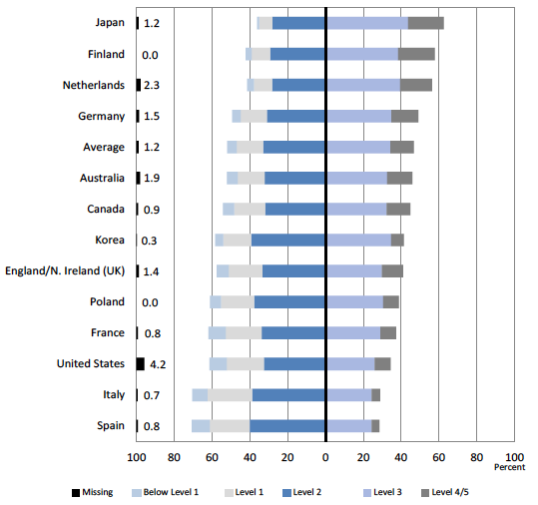
Problem Solving in Technology Rich Environments
PIAAC Data: US
Program for International Assessment of Adult Competencies
OECD 2013: Skills Outlook, p. 87
Notes:
Heather

Slide 5
PSTRE: Adult Immigrants
Level | Description | All | Immigrants
Below 1 | 1 simple task | 18% | 42%
1 | Little or no navigation required | 60% | 39%
2 | Navigation across pages and applications Multiple steps Integration and inferential reasoning | 34% | 22%
3 | Numerous steps, processes, navigation Evaluate the relevance and reliability of information | 7% | 2%
Goodman et al (2013), p. 15
Notes:
Heather

Slide 6
Discussion
What digital literacy challenges do you need to address in your program?
What are you hoping to take away from this session?
What makes you fearful about computer literacy?

Slide 7
Objectives
Background and Rationale

Slide 8
Objectives
Instructional strategies
Background and Rationale

Slide 9
Objectives
Instructional strategies
Example lesson & lesson components
Background and Rationale

Slide 10
Objectives
Instructional strategies
Example lesson & lesson components
Create a Module for Your Program
Background and Rationale

Slide 11
Objectives
Instructional strategies
Example lesson & lesson components
Computer Literacy Topics
Create a Module for Your Program
Background and Rationale

Slide 12
A Glimpse of various programs
BEST Corp. Hospitality Training Center
Watertown Public Library, Project Literacy
Carlos Rosario Public Charter School
Notes:
Computer/Tech Workshops
4 levels: Basics, Beginner, Intermediate & Advanced
2.5 hours / once a week
1 - 4 sessions
Challenges:
Not enough students at basic and advanced levels
Work schedules
ESL Classes & Computer Skills
All English classes go into the Tech Center once in 2 weeks - 30-60 mts.
Challenges:
A wide spectrum of computer skills
No tech curriculum
WPL, Project Lit
Founded over 25 years ago
250 students annually, over 100 tutors
Computer workshops only offered at the basic level
20 students max; once a week; 2 hour sessions
11-13 weeks
Challenges:
Not enough space – waiting list
No higher levels
Only offered 1 cycle / yr – usually Feb-June
Carlos Rosario
M-F, 3hrs, 19 wks
20 students per class
ESL Levels 4-8 = NRS Low Int. – Adv.
1-5 native speakers
Usually
<5 have never touched a computer
5-10 have surfed the internet
5-10 have an email account
<5 have used MS Word or PPT

Slide 13
Instructional Strategies
Make connections (prior learning, background knowledge)
You do, I do, we do, you do – repetition
Situated within students’ experience (personalization)
Cooperative, project-based experience
Language – elaborated and scaffolded

Slide 14
Guiding Principles
Use the Internet for communication and finding information
Be safe in a digital environment
Use software that is meaningful to their lives and helpful for their future
Be informed technology consumers
Gain efficiency and confidence
Ultimate Objective
Technology becomes an integrated part of their lives!

Slide 15
Objectives
Stated simply
Written in terms of what students will learn or do
Echevaria & Graves (2007). Sheltered content instruction: Teaching English language learners with diverse abilities. 3rd Ed. Boston: Allyn & Bacon.

Slide 16
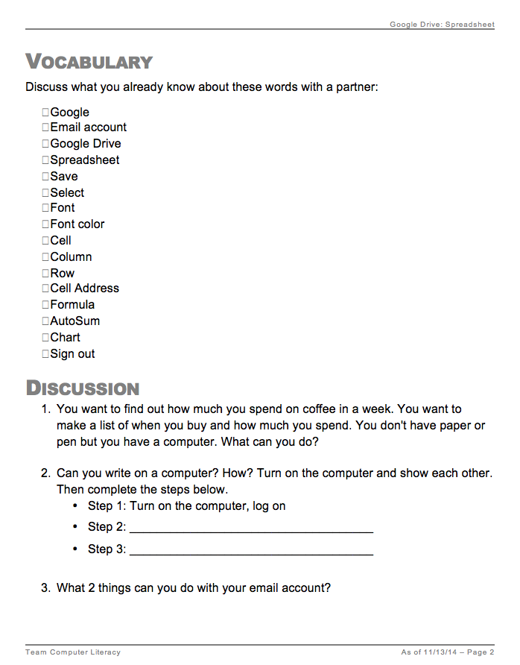
Vocabulary & Building Background
Introducing vocabulary
Connecting to the new content
From personal experience
From prior lessons
Exploring to learn

Slide 17
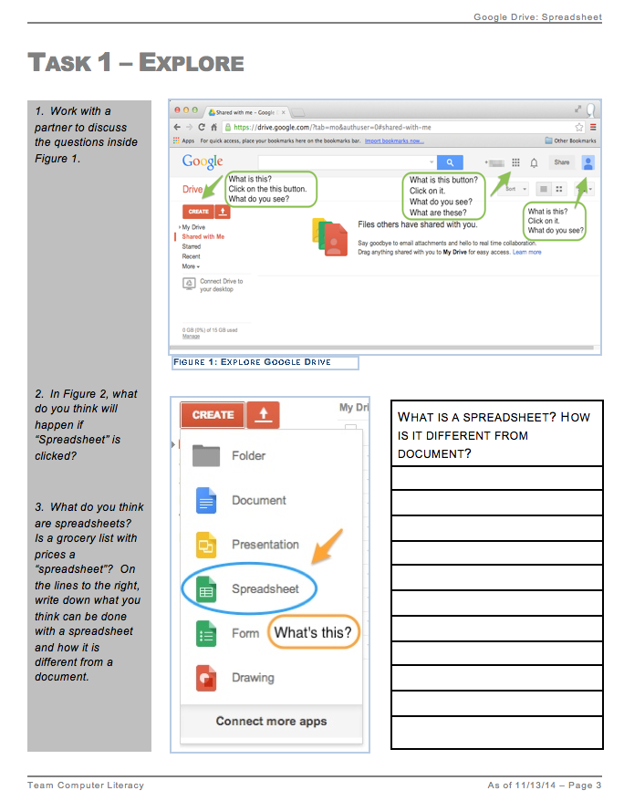
Exploring to Learn
Guided exploration
Peer collaboration
Predicting function

Slide 18
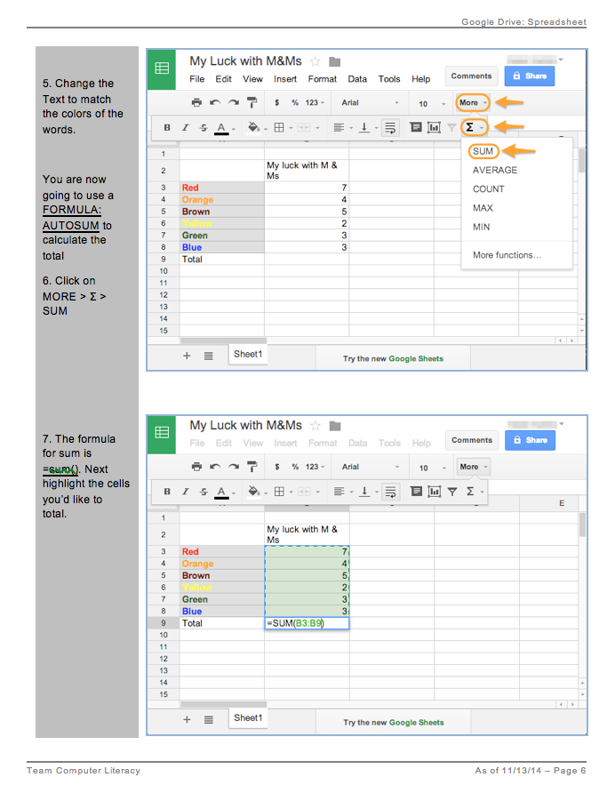
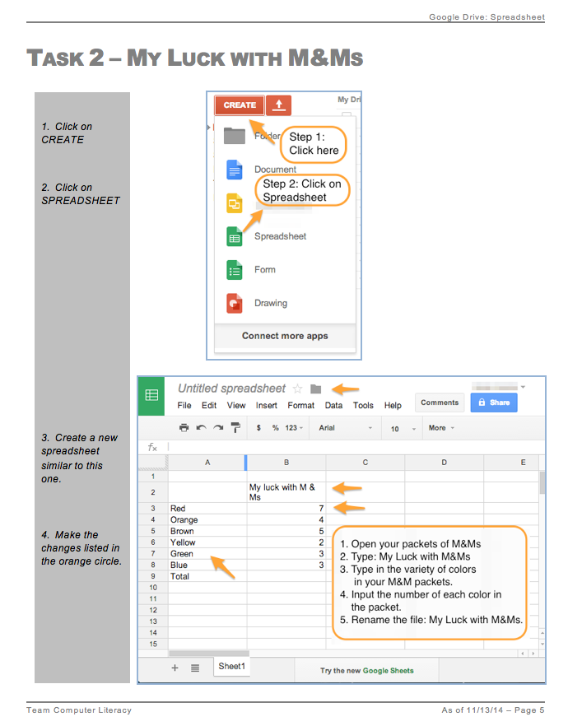
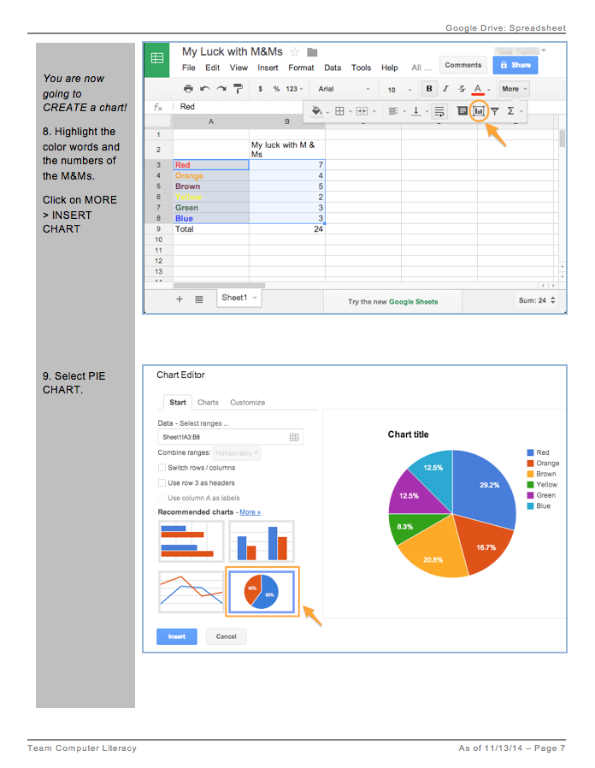
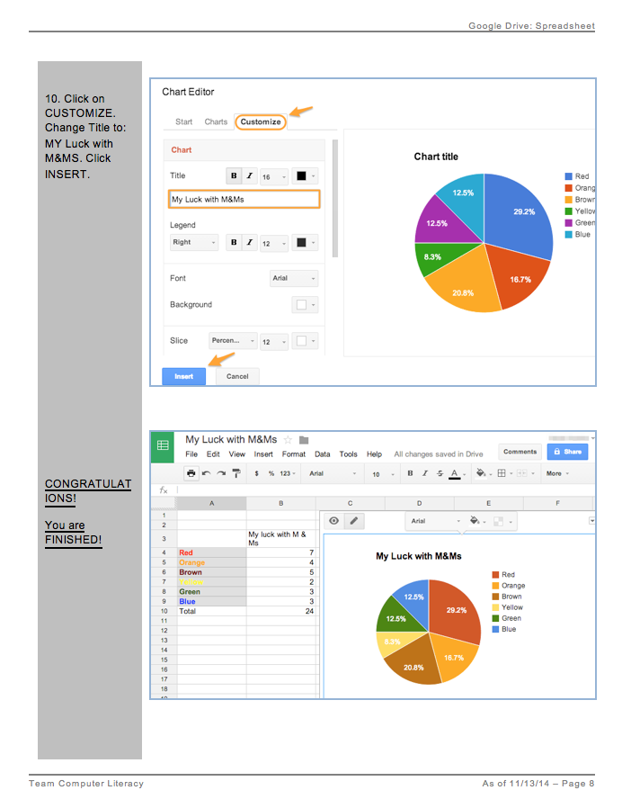
Step-by-Step
Guided step-by-step instructions
Image of outcome

Slide 19
Project-Based Learning
Contextualization
Personalization increases
Motivation
Engagement
Amount learned
Perceived competence and levels of aspiration
Cordova & Lepper, 1996. Intrinsic motivation and the process of learning: Beneficial effects of contextualization, personalization, and choice. Journal of Educational Psychology, Vol 88(4), Dec 1996, 715-730.

Slide 20
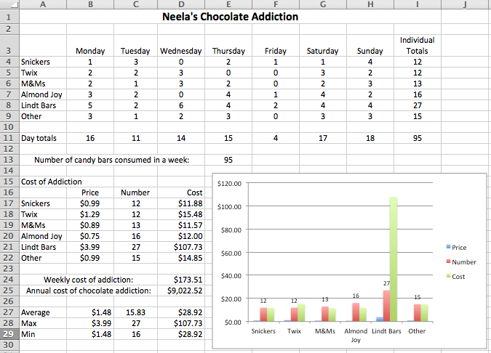

Slide 21
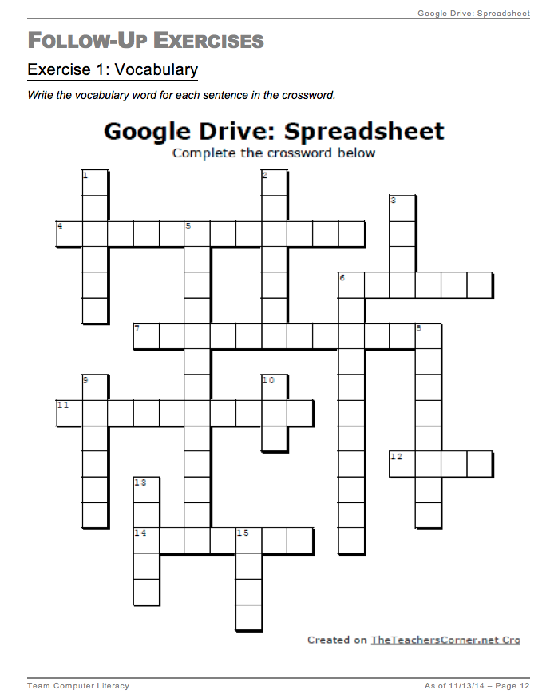
Vocabulary Review
Circle back to original vocabulary

Slide 22
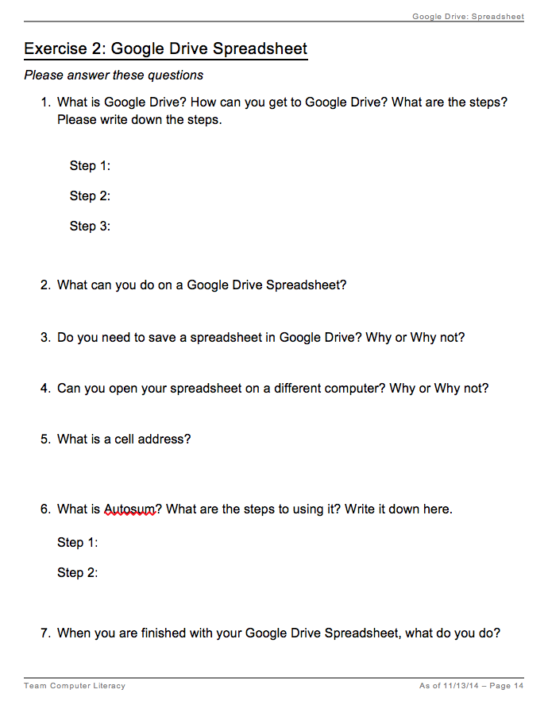
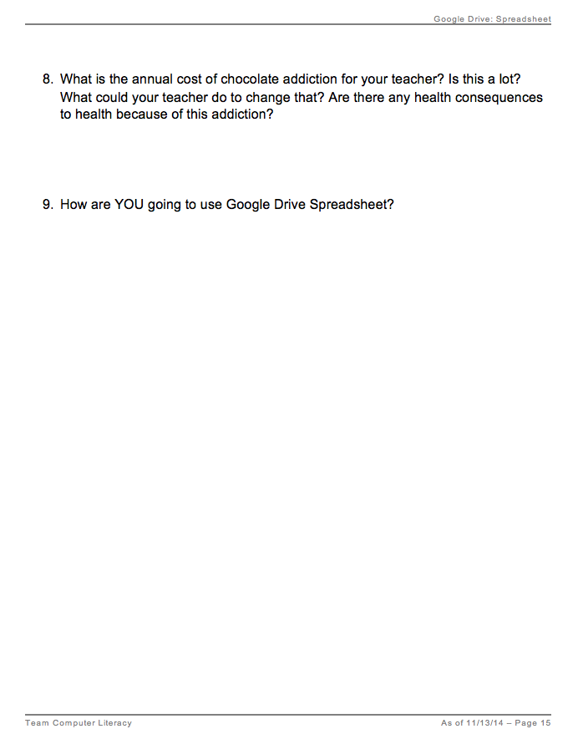
Big Ideas + Real Life
Circle back to the Objectives
Discuss how S plans to use this technology in his/her life.

Slide 23
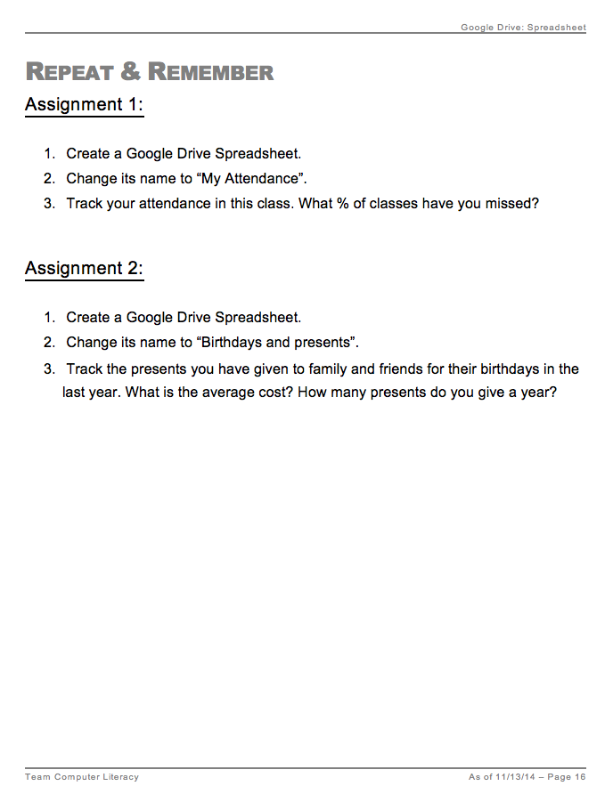
Extension – Repeat & Remember
Tasks to do on their own

Slide 24
Lesson Components
Student Handout
Objectives
Vocabulary & Building Background
Exploring to Learn
Authentic tasks
Assessment
Follow-up
Repeat & Remember
Connections to real life

Slide 25
What Lessons Do Your Students Need?
Create an outline for your lesson including:
Objectives | What do you want your students to be able to do independently after the lesson?
Building Background | What do your students already know? How can you elicit that thinking?
Vocabulary | What words do they need to know?
Exploring to Learn | What do you want them to try on their own first?
Guided practice | What will you have them do step-by-step?
Authentic tasks | What real-life project will they do?
Assessment | What follow-up will you do? What task can they do to practice and reinforce learning?

Slide 26
Create Your Lesson

Slide 27
Lesson Components
Student Handout
Objectives
Vocabulary & Building Background
Exploring to Learn
Authentic tasks
Assessment
Follow-up
Repeat & Remember
Connections to real life
Teacher’s Guide
NRS/SPL levels
Timeframe
Assumptions
Instructional strategies
Metaphors
Exit ticket ideas

Slide 28
Lesson Accessories
Screencasts
Online quizzes
Connections to existing resources
GCF Learn Free
Resources on our website
www.teamcomplit.weebly.com

Slide 29
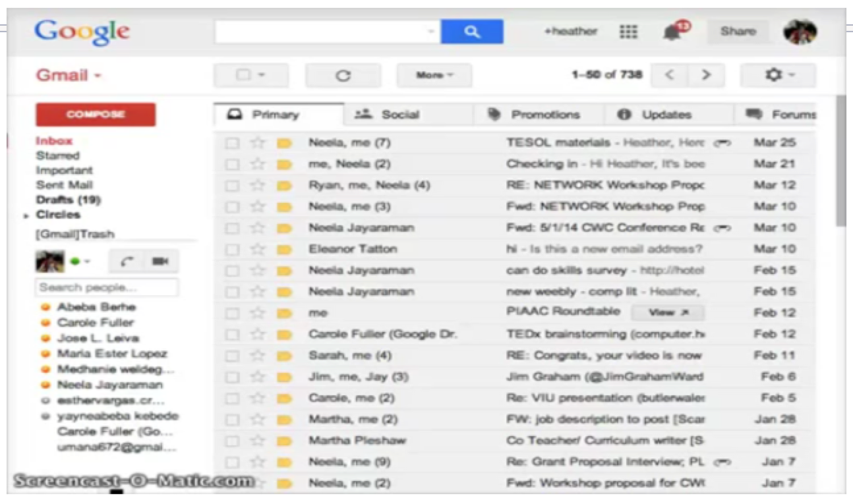
Spreadsheet Screencast
https://www.youtube.com/watch?v=_LJbNu1YO1c

Slide 30
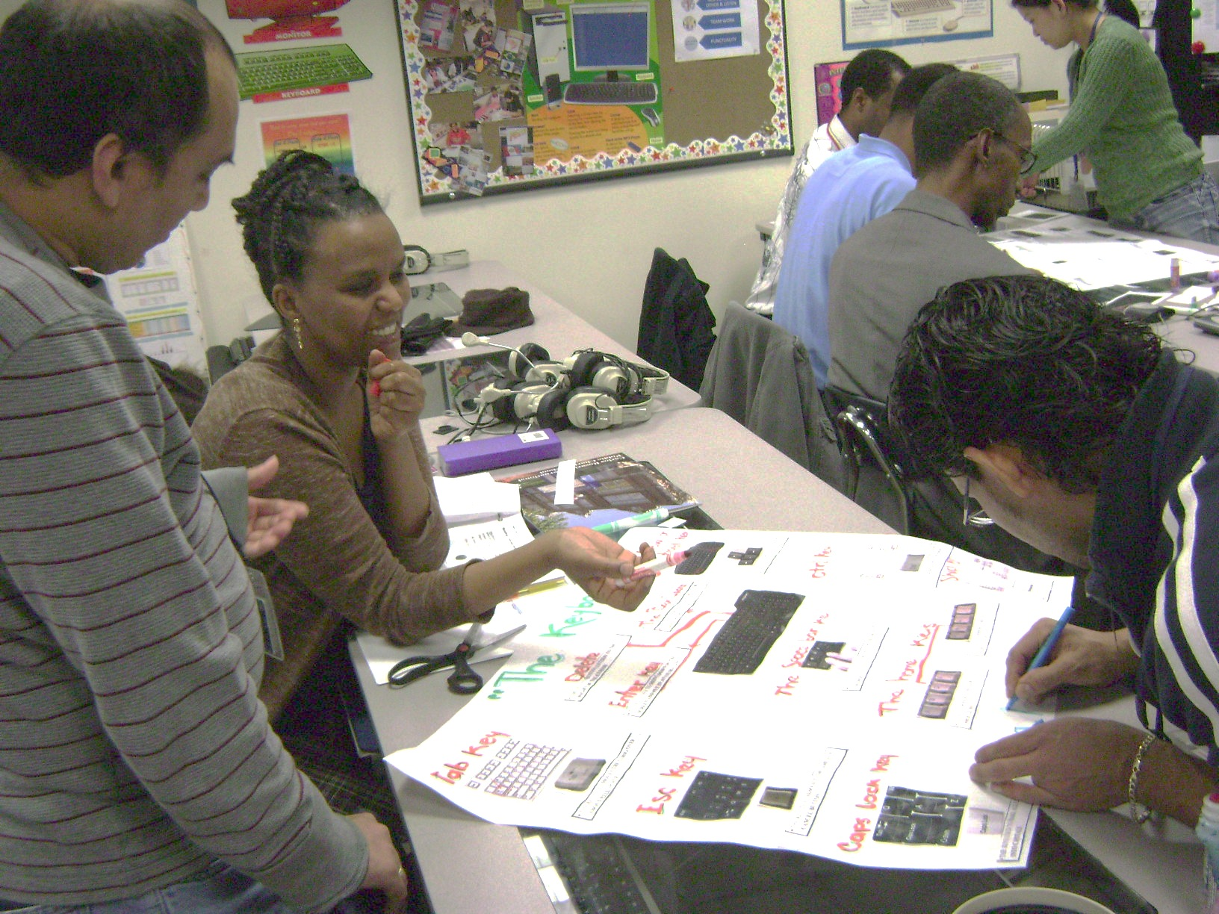
Suggested Sequence – Phase 1
Hardware
OS
Notepad
Software
Internet
Email
Privacy
Gdrive Doc
Components
On/off
Keyboard
Mouse, mouse skills

Slide 31
Suggested Sequence – Phase 1
Hardware
OS
Notepad
Software
Internet
Email
Privacy
Gdrive Doc
Open, close
Minimize, maximize
Icons
Desktop
Task bar

Slide 32
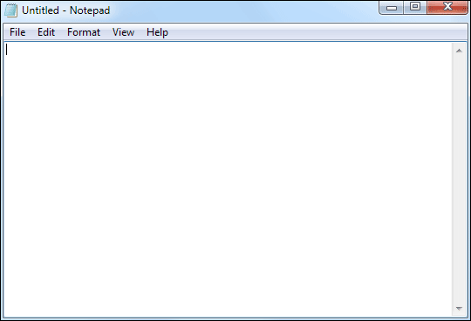
Suggested Sequence – Phase 1
OS
Notepad
Software
Internet
Email
Privacy
Gdrive Doc
Hardware
Typing
Saving
Mouse pointers
Highlighting text
Copy/paste

Slide 33
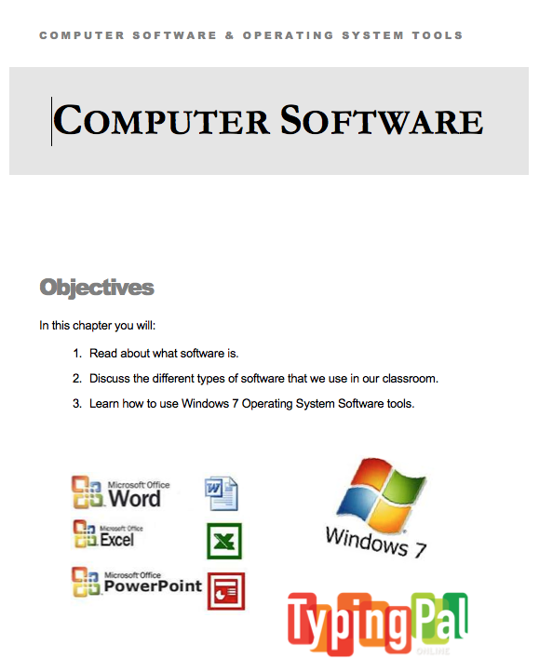
Suggested Sequence – Phase 1
Hardware
OS
Notepad
Software
Internet
Email
Privacy
Gdrive Doc
Types of programs
Purpose of programs
Web browsers

Slide 34
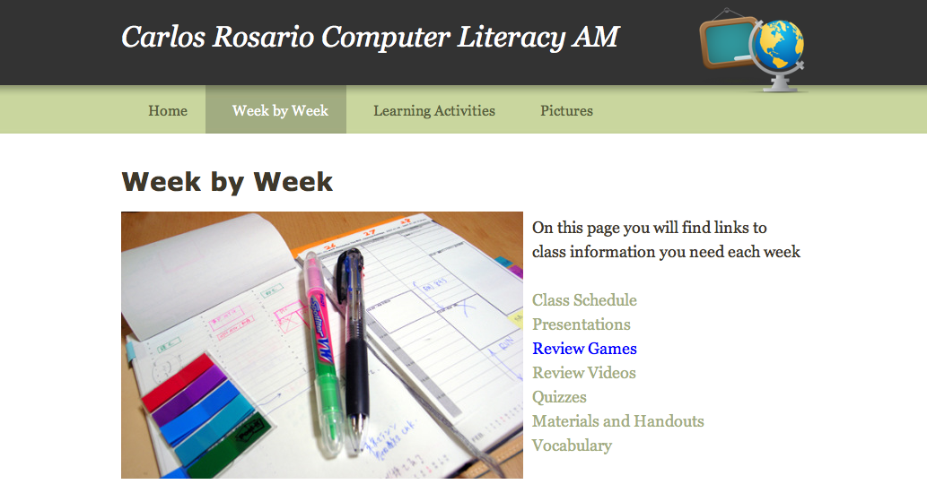
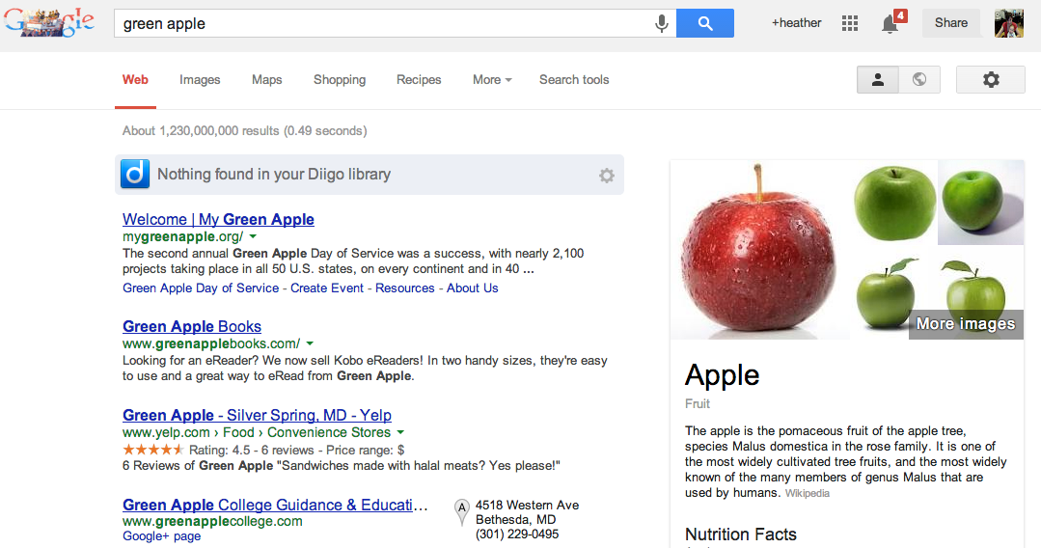
Suggested Sequence – Phase 2
Hardware
OS
Notepad
Software
Internet
Email
Privacy
Gdrive Doc
Features
Vocabulary
Search engines
Keyword searches

Slide 35
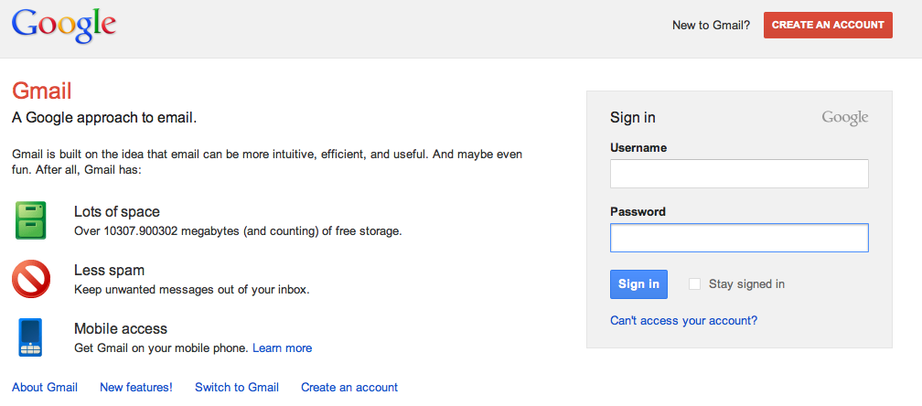
Suggested Sequence – Phase 2
Hardware
OS
Notepad
Software
Internet
Email
Privacy
Gdrive Doc
Gmail accounts
Vocabulary
Basics

Slide 36
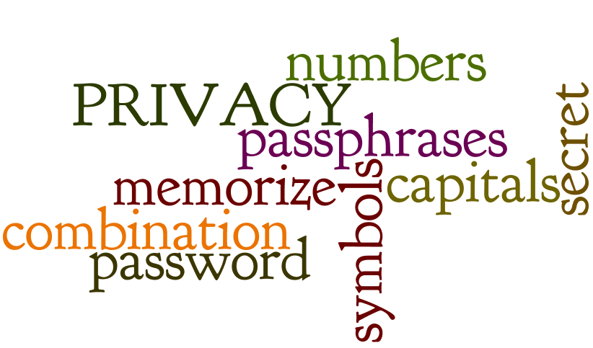
Suggested Sequence – Phase 2
Hardware
OS
Notepad
Software
Internet
Email
Privacy
Gdrive Doc
Passwords
What is private?

Slide 37
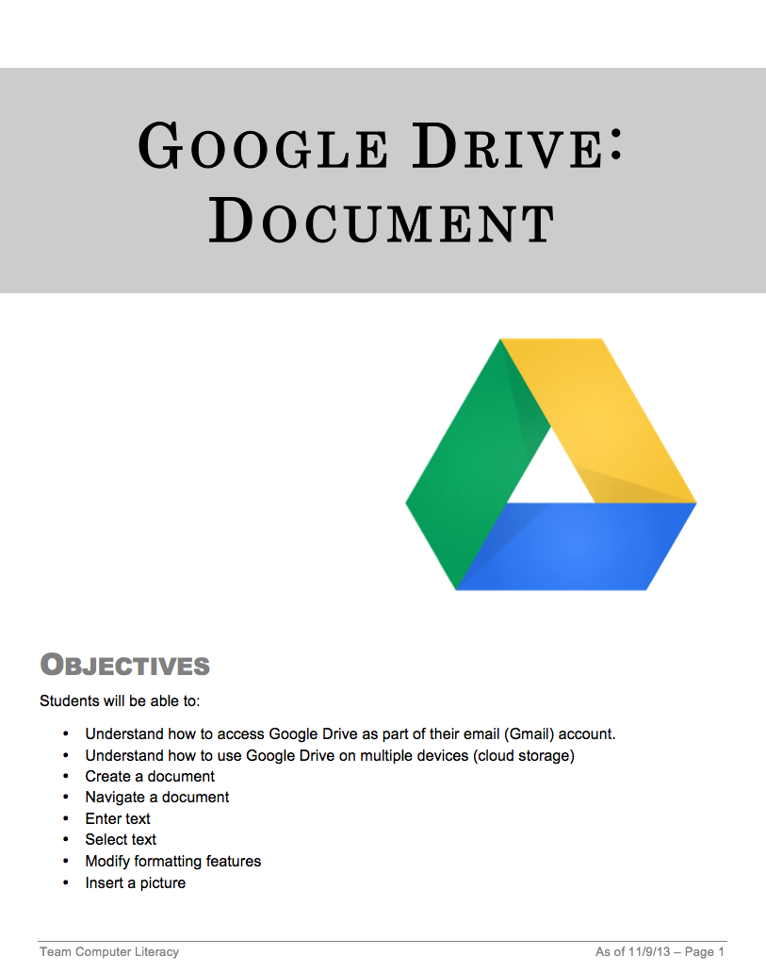
Suggested Sequence – Phase 2
Hardware
OS
Notepad
Software
Internet
Email
Privacy
Gdrive Doc
Basic features
Vocabulary
Create a document

Slide 38
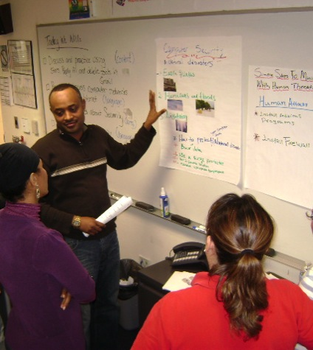
Suggested Sequence – Phase 3
Security
Word
PPT
Excel
OS II
Google Apps
Privacy
II
Digital Lang.
Software II
Physical security

Slide 39
Suggested Sequence – Phase 3
Security
Word
PPT
Excel
OS II
Google Apps
Privacy
II
Digital Lang.
Software II
MS Office Applications

Slide 40
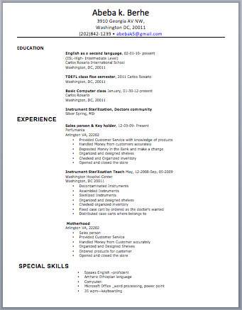
Suggested Sequence – Phase 3
Security
Word
PPT
Excel
OS II
Google Apps
Privacy
II
Digital Lang.
Software II
Compare to Gdrive
Create basic docs

Slide 41
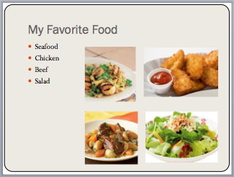
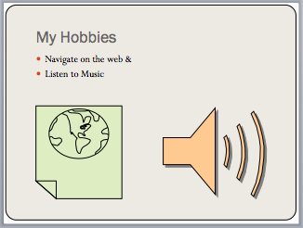
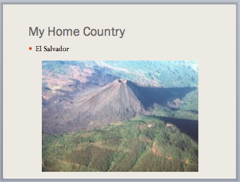
Suggested Sequence – Phase 3
Security
Word
PPT
Excel
OS II
Google Apps
Privacy
II
Digital Lang.
Software II
Compare to Word
Basic presentations

Slide 42
Suggested Sequence – Phase 3
Security
Word
PPT
Excel
OS II
Google Apps
Privacy
II
Digital Lang.
Software II
Compare to Word
Personalize
Basic features/ functions

Slide 43
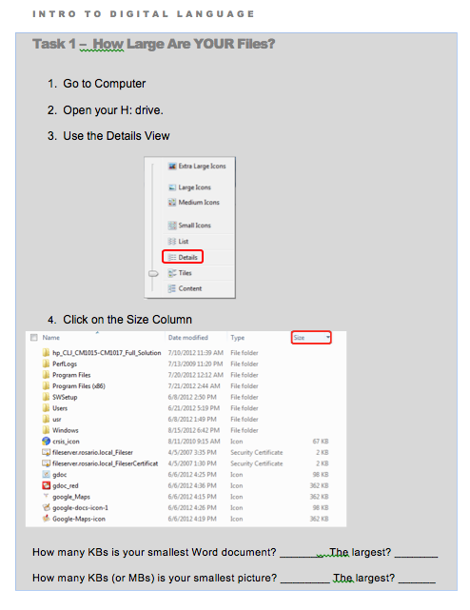
Suggested Sequence – Phase 3
Security
Word
PPT
Excel
OS II
Google Apps
Privacy
II
Digital Lang.
Software II
File management

Slide 44
Suggested Sequence – Phase 3
Security
Word
PPT
Excel
OS II
Google Apps
Privacy
II
Digital Lang.
Software II
Mail
Drive
Calendar
Chrome & Apps

Slide 45
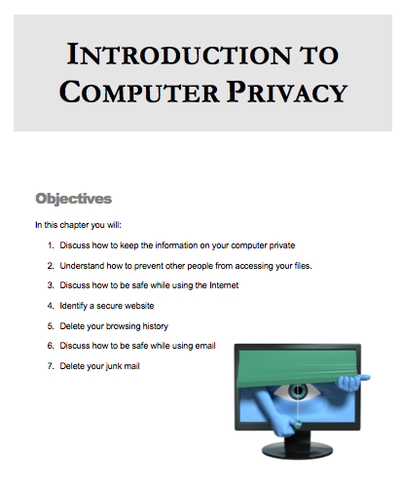
Suggested Sequence – Phase 3
Security
Word
PPT
Excel
OS II
Google Apps
Privacy
II
Digital Lang.
Software II
Spam
Scams
Secure websites
Browsing history

Slide 46
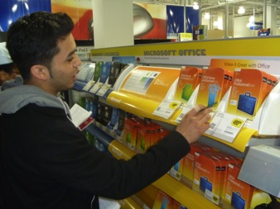
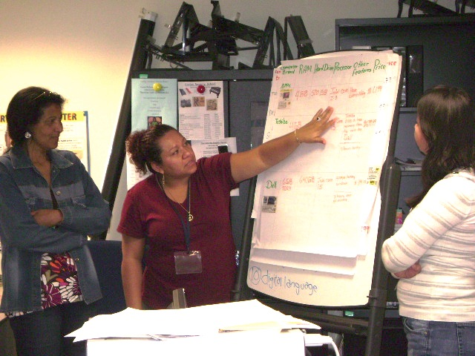
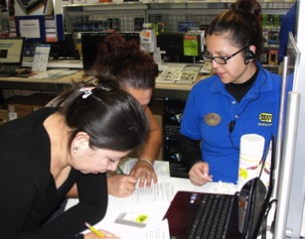
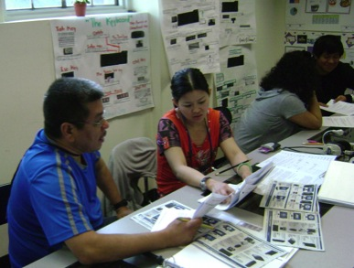
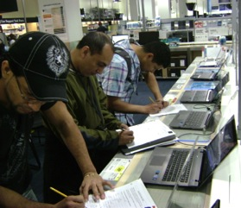
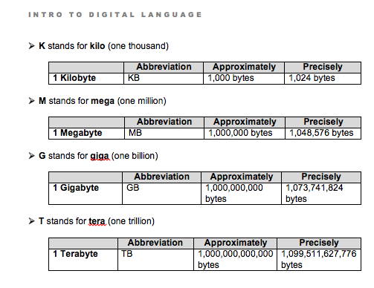
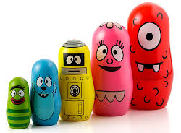
Suggested Sequence – Phase 3
Security
Word
PPT
Excel
OS II
Google Apps
Privacy
II
Digital Lang.
Software II
Capacity
Vocabulary (KB, MB, GB)
Internal/external/flash drives
Cloud
How to buy a computer

Slide 47
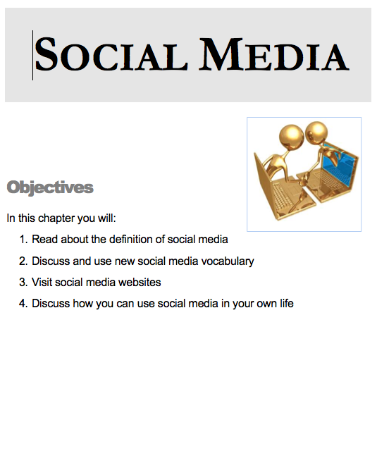
Suggested Sequence – Phase 4
Privacy III
Networks & VOIP
Creating
Websites
OS III
Social Media
Twitter
Google +
Facebook
Blogs

Slide 48
Suggested Sequence – Phase 4
Privacy III
Networks & VOIP
Creating
Websites
OS III
Social Media
Privacy settings on social networking sites

Slide 49
Suggested Sequence – Phase 4
Privacy III
Networks & VOIP
Creating
Websites
OS III
Social Media
User settings in OS

Slide 50
Suggested Sequence – Phase 4
Privacy III
Networks & VOIP
Creating
Websites
OS III
Social Media
Internet connection types
Voice over IP

Slide 51
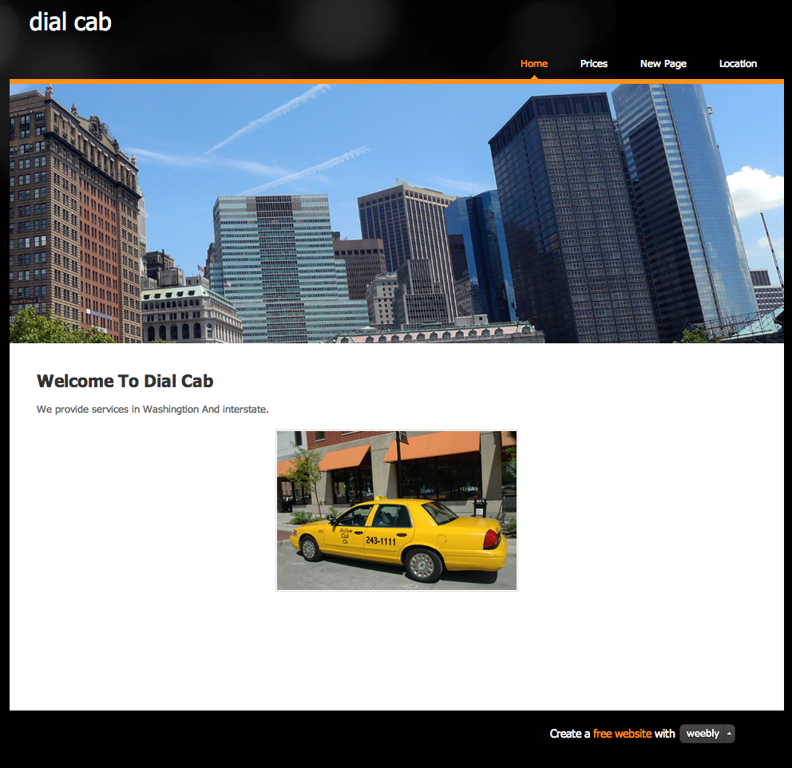
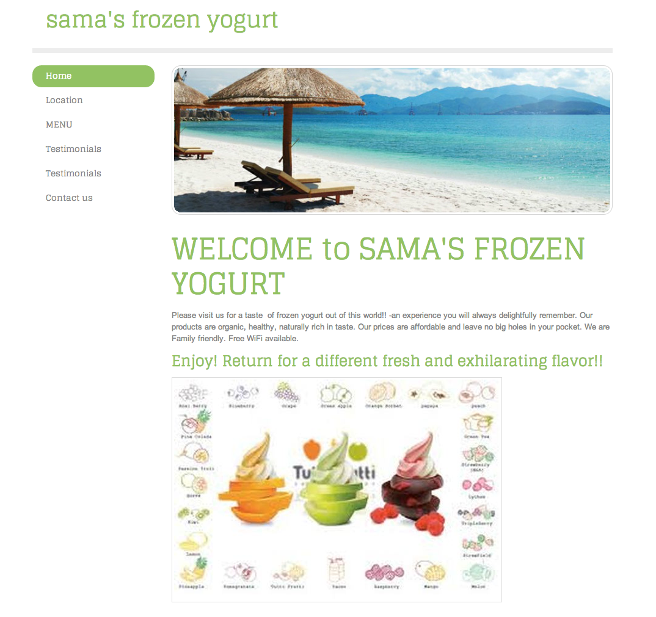
Suggested Sequence – Phase 4
Privacy III
Networks & VOIP
Creating
Websites
OS III
Social Media
Culminating project
Create a business

Slide 52
References
Cordova & Lepper, 1996. Intrinsic motivation and the process of learning: Beneficial effects of contextualization, personalization, and choice. Journal of Educational Psychology, Vol 88(4), Dec 1996, 715-730.
Echevaria & Graves (2007). Sheltered content instruction: Teaching English language learners with diverse abilities. 3rd Ed. Boston: Allyn & Bacon.
Goodman, M., Finnegan, R., Mohadjer, L., Krenzke, T., and Hogan, J. (2013). Literacy, Numeracy, and Problem Solving in Technology-Rich Environments Among U.S. Adults: Results from the Program for the International Assessment of Adult Competencies 2012: First Look (NCES 2014-008). U.S. Department of Education. Washington, DC: National Center for Education Statistics. Retrieved [date] from http://nces.ed.gov/pubsearch.
Pugh, 1989. Metaphor and Learning. Reading Research and Instruction, v. 28, 3

Slide 53
Thank you!
Visit us for future lessons at
www.teamcomplit.weebly.com
Team Computer Literacy:
Heather Tatton-Harris & Neela Jayaraman
Contact us! teamcomplit@gmail.com

