Slide 1
Making Learning Computer Literacy Fun & Useful
Neela Jayaraman
Technology & Education Systems Coordinator
BEST Corp. Hotel Training Center
Apr 5, 2013

Slide 2
Raise your hand if you are…
Instructor
  Adult Computer Literacy Instructor
  Adult ESL Instructor
  Career & Technical Education Instructor
  ABE / GED Instructor
  Other instructors
Program Coordinator/Administrator
Curriculum Developer
None of the above

Slide 3
Raise your hand if you’re here for…
Absolute beginner users
Low-level users
Intermediate users
Advanced users
Staff & Teachers
Other

Slide 4
Computer Literacy
How would you describe your computer literacy program?
What are the targets for students?
What is your main concern / specific area of interest? What are you hoping to take-away today?
How big is your program? How many staff vs. students?

Slide 5
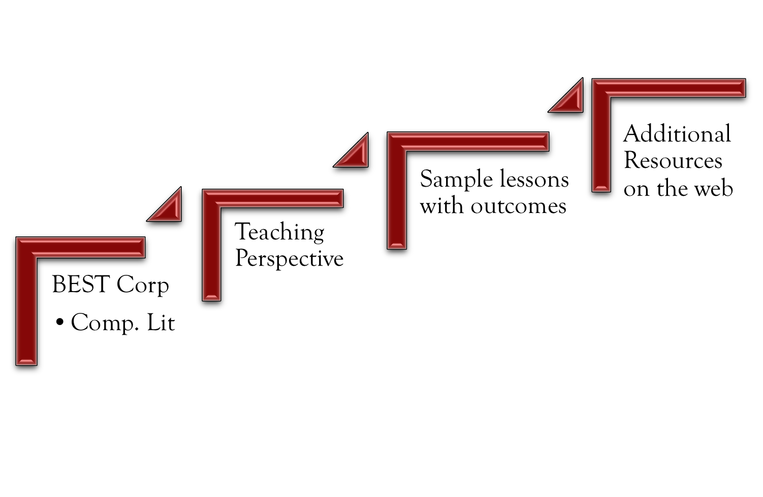
Objectives
Notes:
PowerPoint SmartArt offers a variety of options. List, Process, Cycle, Hierarchy etc.
Teaching ideas: What are the steps to turning on a computer. For lower level students, put it in jumbled and have them identify the steps. Great practice for sequencing.
*

Slide 6
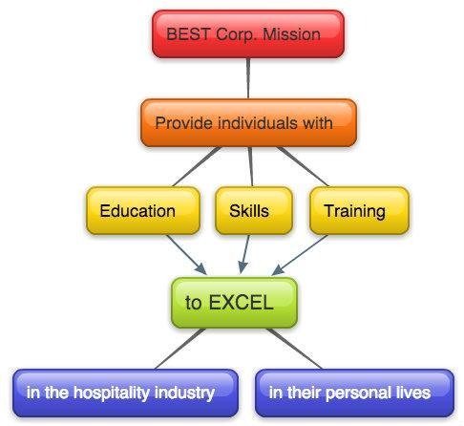
Notes:
Created with Bubl.us – needs a login but is free
Teaching ideas:
Comp. Lit. - Plan the the steps involved in buying a computer, giving a talk, going to college
ESL: Any process that requires discrete steps. Getting a driver’s license, steps to writing etc.
Elicit more!
*

Slide 7
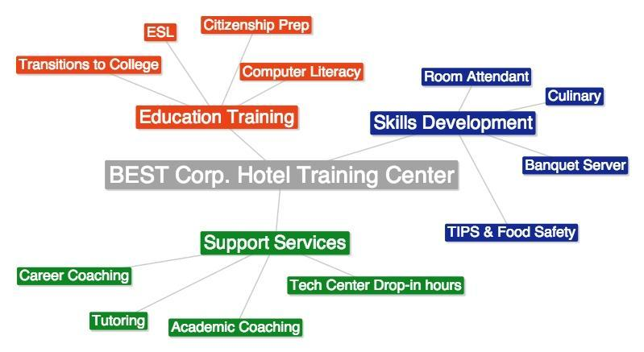
Notes:
Done online for free with text2mindmap. No account necessary.
Can easily be integrated into another lesson as a prep step. Lower levels can handwrite first before they do this online. Excellent practice at organizing thought and distinguishing what is relevant from off-topic. Examples:
*

Slide 8
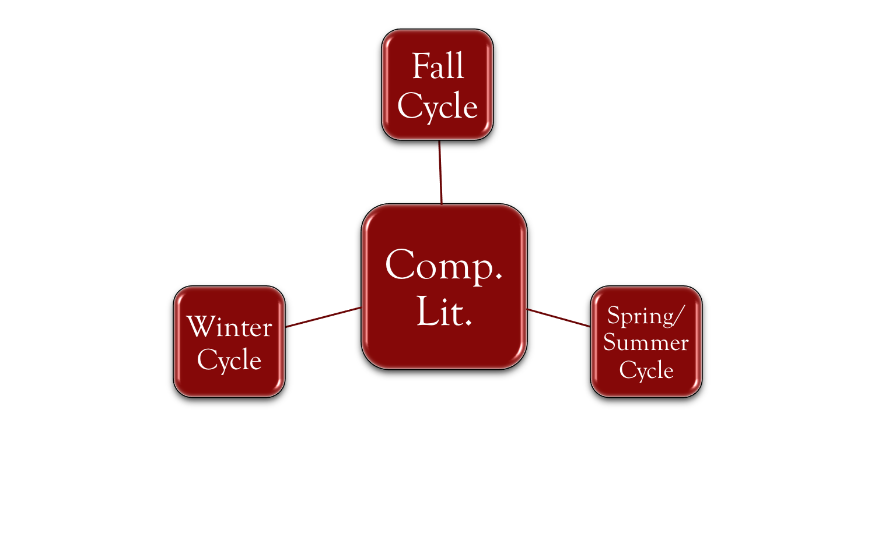
Computer Literacy at BEST Corp.
14 weeks
Once a week: 2-2.5 hrs
Classes run by volunteer tech teachers
Fall 2012: 2 levels
Switched from classes to workshops
Winter 2013: 4 levels
Online self-checklist
Online reservation

Slide 9
Teaching Perspective
Content, examples and explanations are situated within students’ experience
Comp lit should not be isolated from other learning experiences or parts of their lives
I do, we do, you do. Repetition is key!
Language! Don’t oversimplify or use too much jargon
Using multiple intelligences – Kinesthetic and visual often much more effective!
Elicit and mine information as much as possible
Notes:
*

Slide 10
Situating content in familiar context
How would you best explain these?
Windows Desktop
Programs
Icons on the desktop
Save vs. Save as
Reply vs. forward
Cloud storage (Email / Google Drive)
OS vs. programs / applications

Slide 11
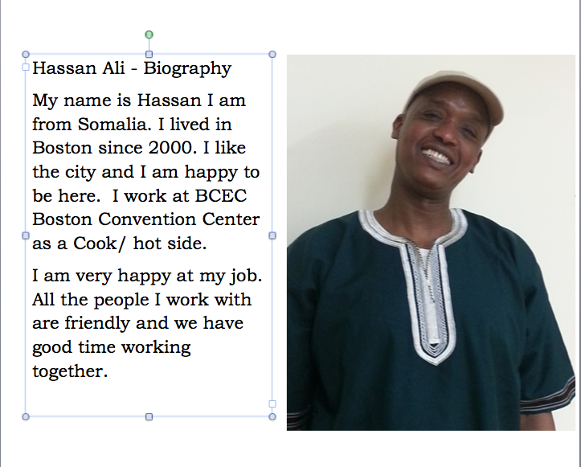
Lessons & Outcomes: MS Word
Level: Beginner
MS Word I
Using smart phones we took photos
I emailed the students their picture
They learned to insert picture, write a short text
Et voila! A biography!
Notes:
They also learned to talk about themselves; to tell their story. They were very happy to work with a photo of themselves as they were on that day and once finished with this assignment, wanted very much to send their work to family and friends. This lesson is a huge confidence booster!
*

Slide 12
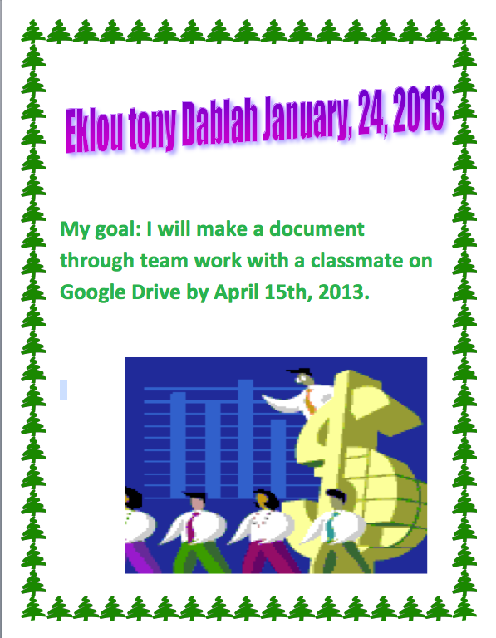
Lesson & Outcomes: MS Word
Level: Intermediate
MS Word I
A discussion of all workshops and contents offered
Students start to think about what they want to learn
We formulate possible goals; students choose a goal among these
We create a Word Document with individual goals and practice formatting, inserting clipart or pictures from the web
Notes:
Stds also learned about setting goals, deadlines and meeting these goals.
*

Slide 13
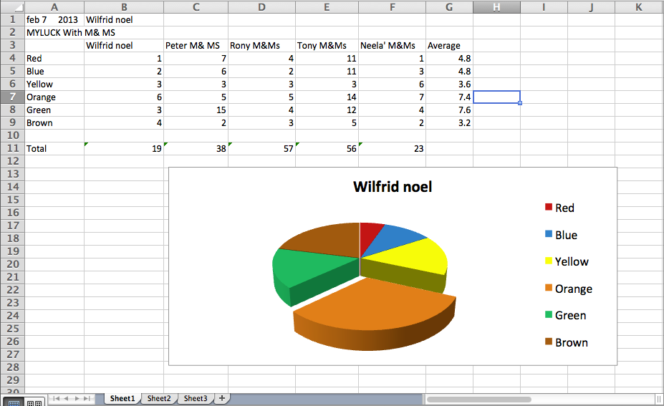
Lessons & Outcomes: MS Excel
Level: Intermediate
MS Excel I
Mini packets of M & Ms used for numerical data
Autosum & Auto Average
Generate chart

Slide 14
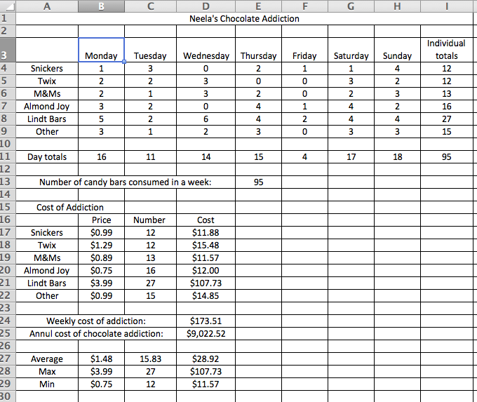
Lessons & Outcomes: MS Excel
Level: Advanced
MS Excel I
Students learn about Neela’s Chocolate Addiction
They learn how to employ formulas
We also have a discussion on the health impact of an unhealthy diet
Students also identify the financial cost of over-eating

Slide 15
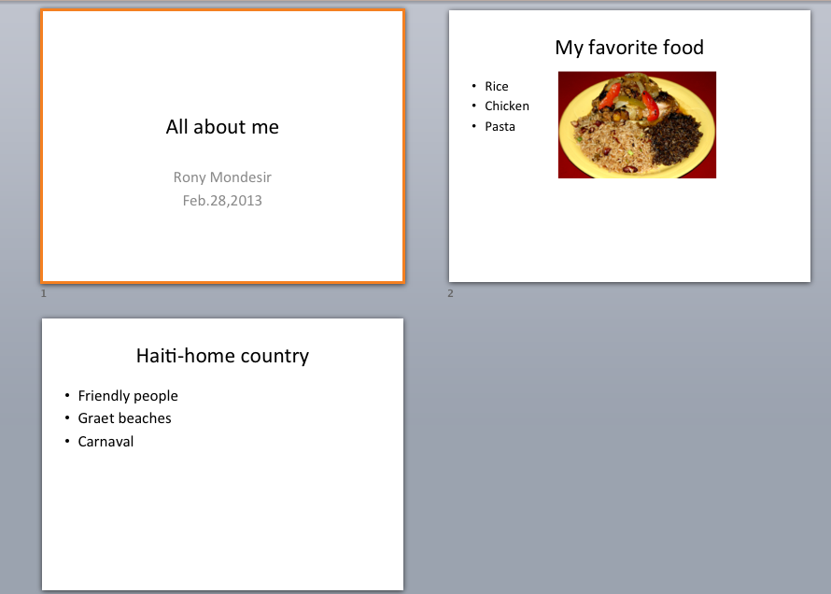
Lessons & Outcomes: MS PowerPoint
Level: Intermediate
MS PowerPoint I
Students create a presentation about themselves
Learn to organize information with an outline
Learn to insert photos

Slide 16
Forum for Sharing
What strategies have you employed that have worked well?
How are computer literacy skills developed in your program?
How would you use any of the material discussed today? Which seemed the most useful? The most fun?
What was something from today that you don’t see working so well? Why not?

Slide 17
Special thanks for generous support to
Heather Tatton-Harris
  (Carlos Rosario Charter School in Washington D.C.)
  Computer Literacy Instructor / Curriculum Specialist
Akira Kamiya
  (SABES, UMASS Boston)
  Computer Field Technologist

Slide 18
Thank you. www.neelastechtools.weebly.com
Please feel free to get in touch with me if you have any questions.
njayaraman@hoteltrainingcenter.org

