Slide 1
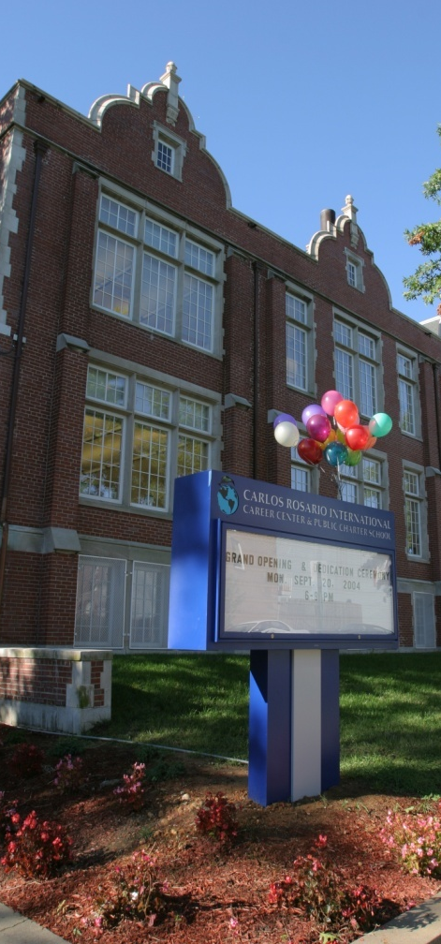

Sheltered Content for an ABE Computer Literacy Course
Heather Tatton-Harris – Carlos Rosario School
Miriam Burt - CAL

Slide 2
Raise Your Hand If…
Computer Literacy Instructor
Family Literacy Instructor
Program Administrator
Workforce/Workplace Instructor
None of the above
Adult ESL Instructor
Career and Technical Education Instructor: Content
Bridge Program
Instructor
ABE/GED Instructor

Slide 3
Computer Literacy Discussion
What is the nature of your computer literacy experience?
What should students learn in a computer literacy class?
What computer skills do students need for college? Workplace? Personal life?

Slide 4
Objectives
Discuss the basics of sheltered instruction
Understand the nature of the CL class at Carlos Rosario PCS
Observe how sheltered instruction is achieved in materials
Review sample materials
Participate in example tasks

Slide 5
Adult English Language Learners:
State of the Field
Federal instruction generally funded by U.S. Department of Education, Office of Adult and Vocational Education
At least 50% of adult learners are ELLs (including those in ABE/GED and ASE courses) (http://wdcrobcolp01.ed.gov/CFAPPS/OVAE/NRS/tables/index.cfm)
Focus on transitioning all adult learners to work or post-secondary education

Slide 6




Models for Providing Content Instruction to ELLs
EL Civics
Bridge Classes
Career/Technical Classes: Co-Instruction
ESP Classes
Sink or Swim
Other

Slide 7
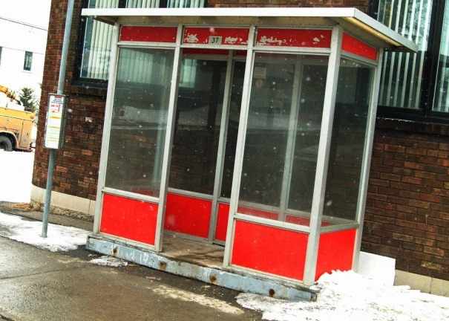
Introduction to Sheltered Instruction and the SIOP Model
Notes:
Sandra, Introduction

Slide 8
Sheltered Instruction: What is it?
Sheltered instruction is intended for English language learners to learn both content and language, without sacrificing either.
“A means for making content comprehensible for English learners while they are developing English proficiency.”
Echevarría, J., Vogt, M.E., & Short, D. (2008). Making content comprehensible for English learners: The SIOP model. Boston: Pearson/Allyn & Bacon, p.246.
Notes:
Sandra, Introduction

Slide 9
How was the SIOP Model developed?
SIOP = Sheltered Instruction Observation Protocol
  Initially, was an observational instrument,
  And evolved into the SIOP Model for lesson planning.
  Was developed for K-12 instruction – for mainstream teachers working with English language learners
Notes:
9
Sandra, Introduction

Slide 10
The SIOP Model
(Echevarria, Vogt, & Short, 2008)
Lesson Preparation – language and content objectives
Building Background – vocabulary development, link to students’ background and to prior learning in class
Comprehensible Input – a variety of ESL techniques, clear explanation, appropriate speech
Strategies – metacognitive and cognitive strategies, scaffolding, higher-order questioning
Notes:
10

Slide 11
The SIOP Model
(Echevarria, Vogt, & Short, 2008)
Interaction – grouping configurations, sufficient wait time, chance for oral output
Practice & Application – hands-on practice with new knowledge, all 4 language skills
Lesson Delivery – meet objectives, promoting learner engagement, pacing
Review & Assessment – review vocabulary and concepts
Notes:
11

Slide 12
The SIOP Model
Shares many features recommended for high quality instruction for all students, such as:
    cooperative learning
    strategies for reading comprehension
    emphasis on the writing process
    differentiated instruction.
Accommodates the distinct second language development needs of ELLs.
Notes:
12

Slide 13
The SIOP Model
Contains key features for the academic success of ELLs, such as the:
  Inclusion of language objectives in every lesson
  Key vocabulary posted and emphasized throughout lesson
  Frequent opportunities provided for student-student interaction
  Use of a variety of techniques to make content comprehensible for ELLs of different proficiency levels
Notes:
13

Slide 14
Overview of Carlos Rosario PCS
Began in 1970 as the community based organization, Program of English Instruction for Latin Americans (PEILA).
Became the first adult education public charter school in the nation in 1998.
Has served over 60,000 immigrants during its 42 years of operation.
Notes:
-Explain how this was not easy.
-School was closed in 1996, worked out of basement of founder’s house
-used pots and pans from home to reestablish the culinary arts training program
-did not have own building, worked out of six small sites (church basements, middle school, etc.)
-like a Phoenix

Slide 15
The Mission
Our mission is to provide education that prepares the diverse adult immigrant population of Washington D.C. to become invested, productive citizens and members of American society who give back to family and community.

Slide 16
Overview of Carlos Rosario PCS
Currently serving 2,200 diverse students through a holistic, three pronged model:
Foundational Skills and Literacy
    Basic Literacy
    ESL
    GED
    Citizenship
    Computer Literacy
Workforce Development Training
    Culinary Arts and Servsafe
    Computer Support Specialist (CSS)
    Nurse Aide Training
Comprehensive Supportive Service
Notes:
Services including: one one one counseling, workshops on homebuying, financial literacy,

Slide 17
Computer Literacy at Carlos Rosario
M-F, 3hrs, 19 wks
20 students per class
ESL Levels 4-8 = NRS Low Int. – Adv.
1-5 native speakers
Usually
  <5 have never touched a computer
  5-10 have surfed the internet
  5-10 have an email account
  <5 have used MS Word or PPT

Slide 18
Student Profiles – Yrs. of Education

Slide 19
Student Profiles – 1st Languages

Slide 20
Student Profiles – Age Ranges

Slide 21
Computer Literacy - Guiding Principles
Use the Internet for communication and finding information
Be safe in a digital environment
Use software that is meaningful to their lives and helpful for their future
Be informed technology consumers
Gain efficiency (typing speed) and comfort with a computer
Notes:
Are these specific to the Carlos Rosario CL class? Or more general for all CL classes?
Perhaps add something about typing speed and efficiently navigating a computer
I think it’s also important to mention somewhere why CR decided we needed this class. After all, all our ESL students go to the computer lab each week and use computers within the classroom, yet this doesn’t seem to be enough exposure. Even some of our Level 8 students who have taken ESL classes at CR for 4+ years, exit level 8 with few computer skills.

Slide 22
Overview of Topics
Hardware
Keyboard
Software / OS
Internet
Email & etiquette
Word
PPT
Excel
Job searching
Digital language
Connecting to the Internet
Computer safety
Computer privacy
Social media
VOIP
Creating a website

Slide 23
Materials, Books?
Problem
Solution
Computer literacy books (Internet & Computing Core - IC³)
ESL computer literacy books
None that meet the language needs of CR students AND to cover a semester’s range of objectives
Created sheltered materials adapted from
  MS Digital Literacy Curriculum
  Consumer Action Publications
  Pearson Learning Microsoft Office publications (2007 & 2010)
  Variety of web resources

Slide 24
Chapter Features
Content & language objectives
Comprehensible texts
Vocabulary development
Background, prior knowledge and experience
Authentic outcomes
Content and language
Comprehensible
Vocabulary
Building background
Authentic outcomes

Slide 25
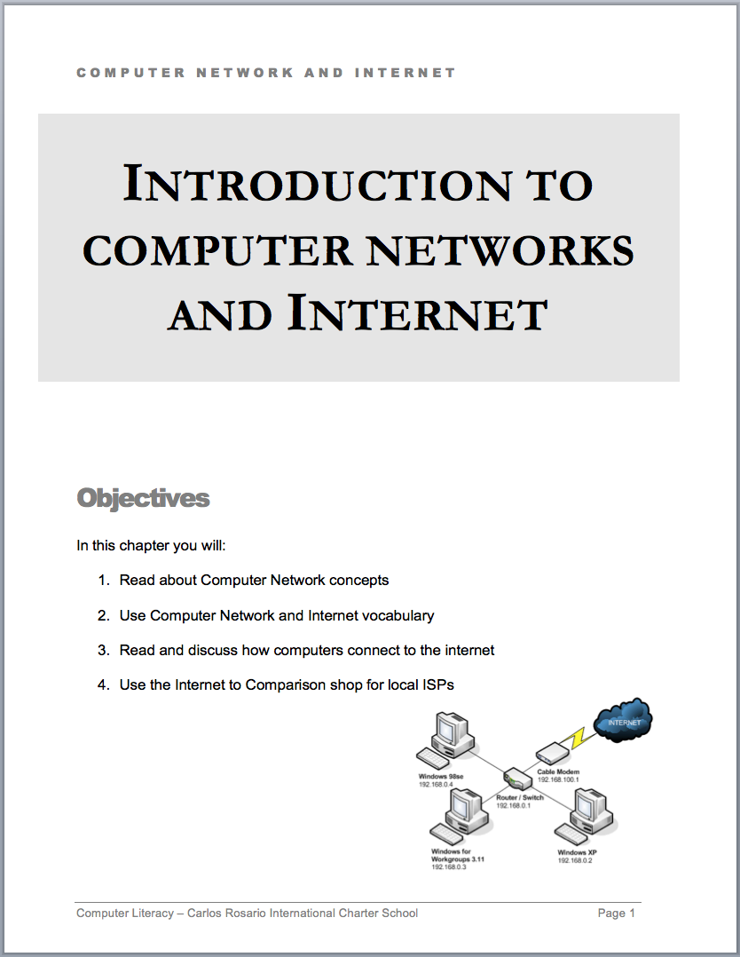

Content & Language Objectives
On board:
  Discuss similarities between Word and PPT
  Read about features of PPT
  Write about yourself by creating a PPT presentation using the features we learn
On board:
  Read about Computer Network concepts
  Discuss what we read using new vocabulary.
  Draw and Describe the CR school network
  Navigate the Internet to comparison shop for ISPs; document comparison prices
Content and language
Comprehensible
Vocabulary
Building background
Authentic outcomes

Slide 26
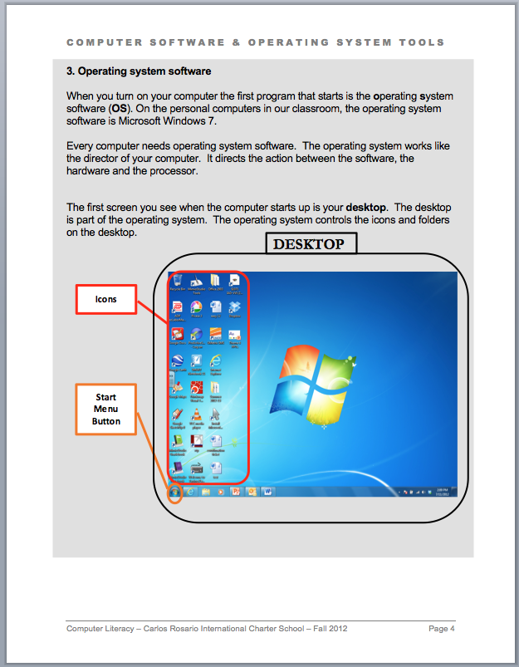
Comprehensible Texts
Readability
  Shortened sentences
  Simplified vocabulary
  Elaboration
Previewing vocabulary
Visual support
Content and language
Comprehensible
Vocabulary
Building background
Authentic outcomes

Slide 27
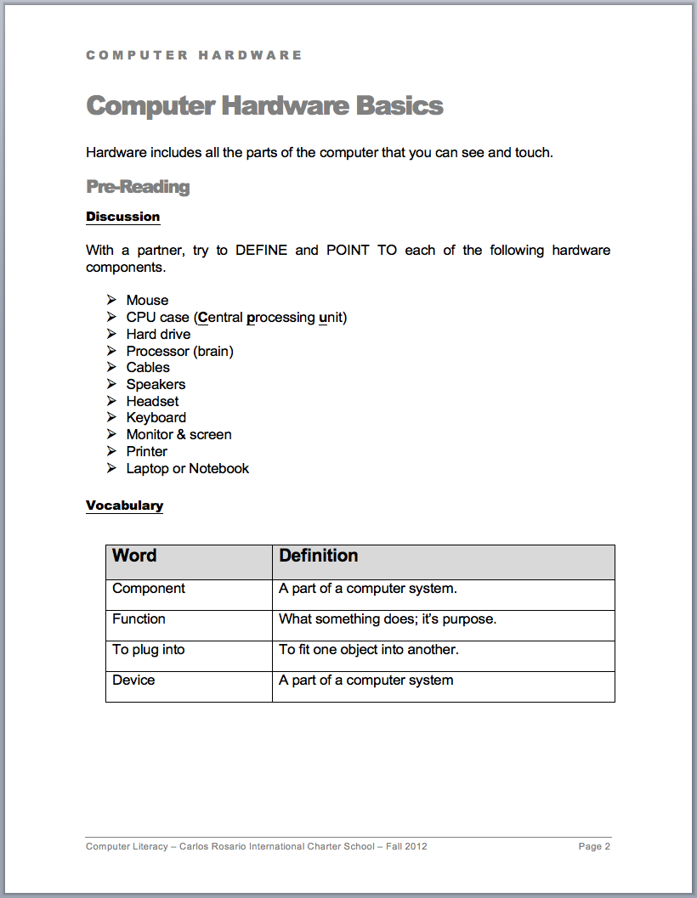
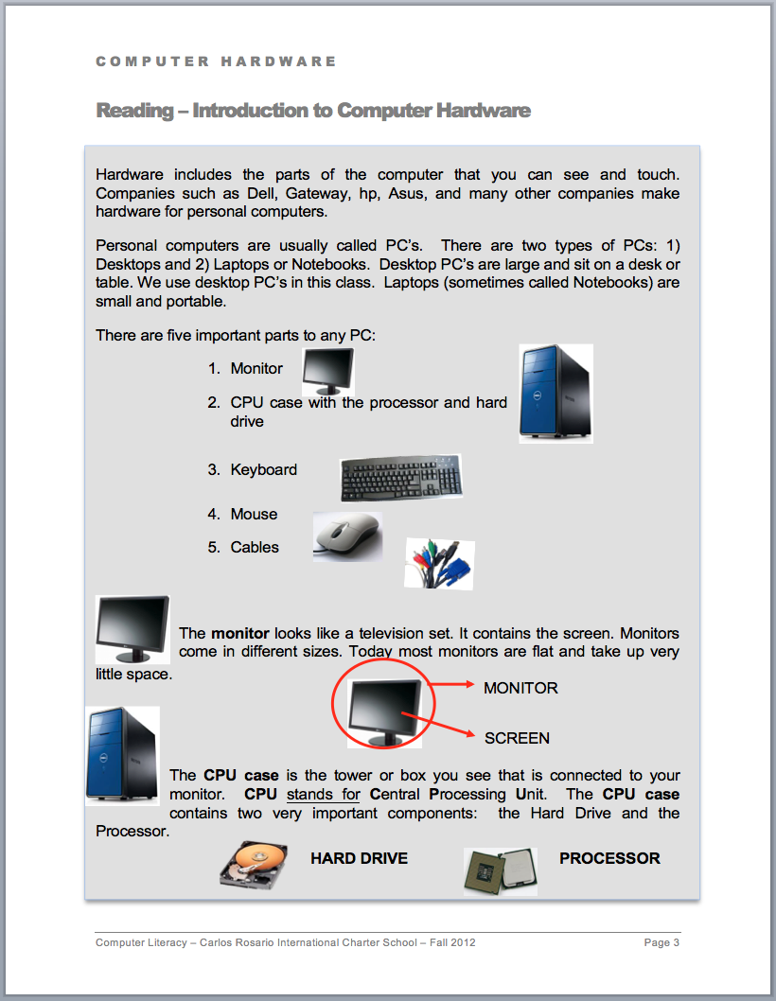
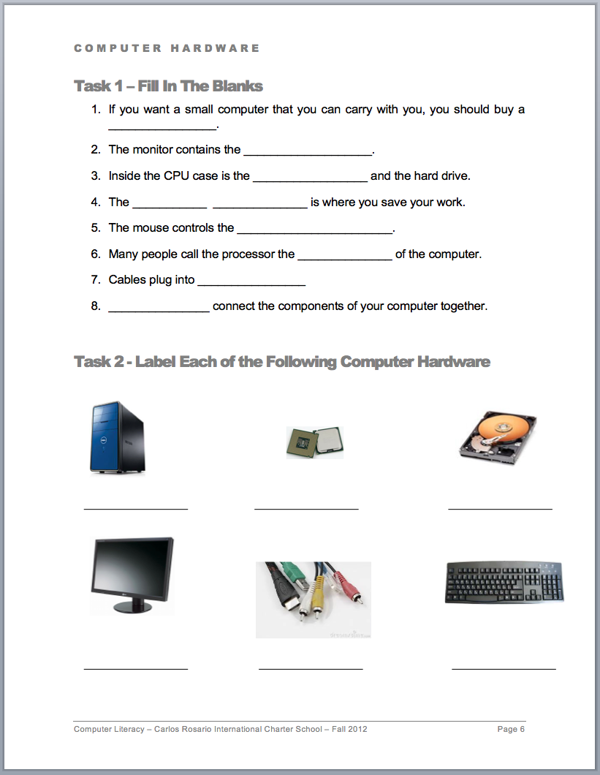
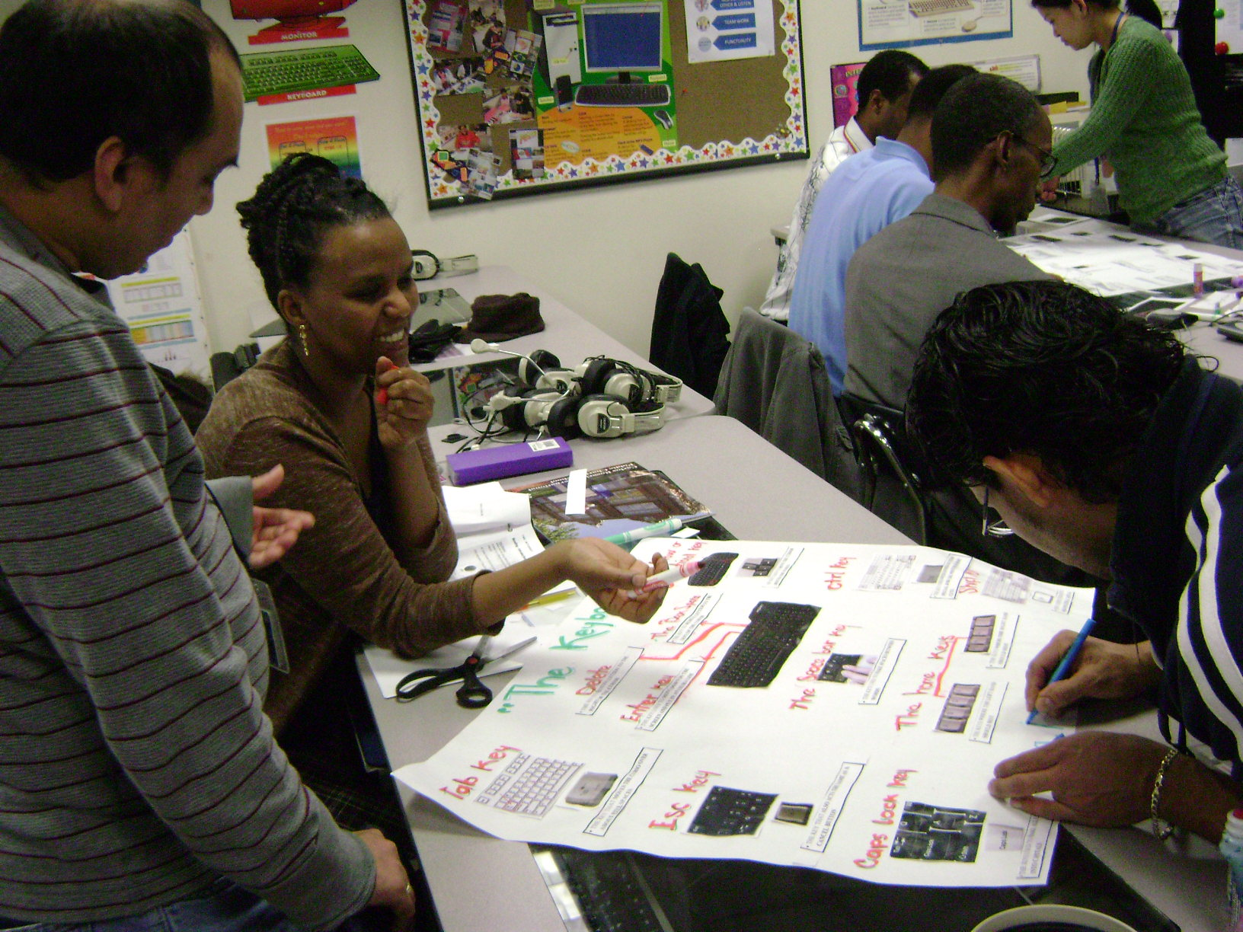
Vocabulary Development
Preview
Visual support
Review
Content and language
Comprehensible
Vocabulary
Building background
Authentic outcomes

Slide 28
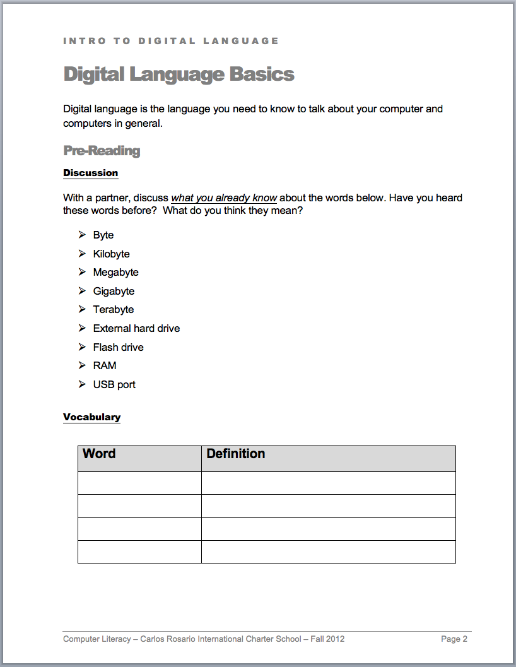
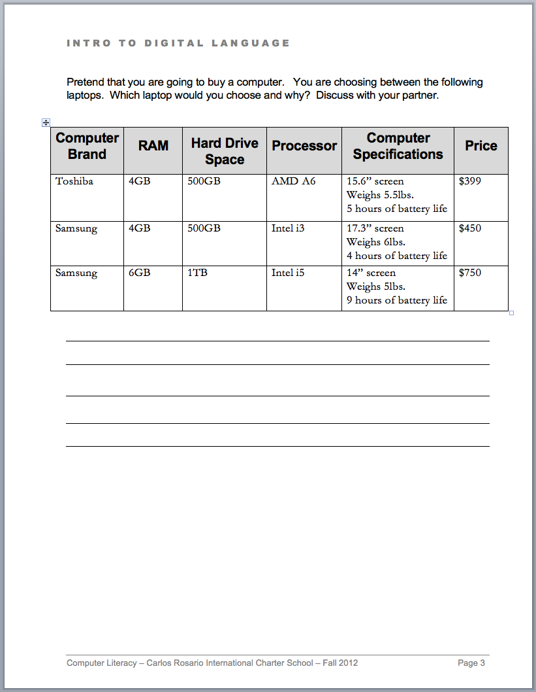
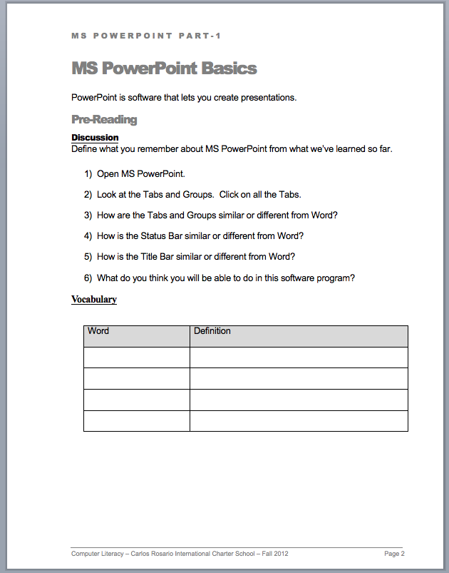
Building Background
What do the students already know?
  Exposure to vocabulary
  Prior experience
  Observations
Content and language
Comprehensible
Vocabulary
Building background
Authentic outcomes

Slide 29
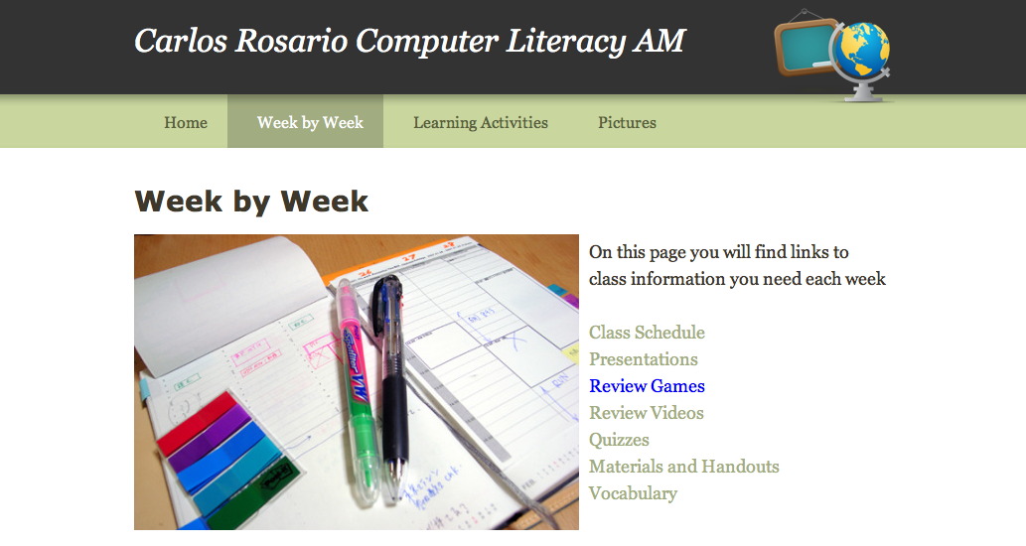
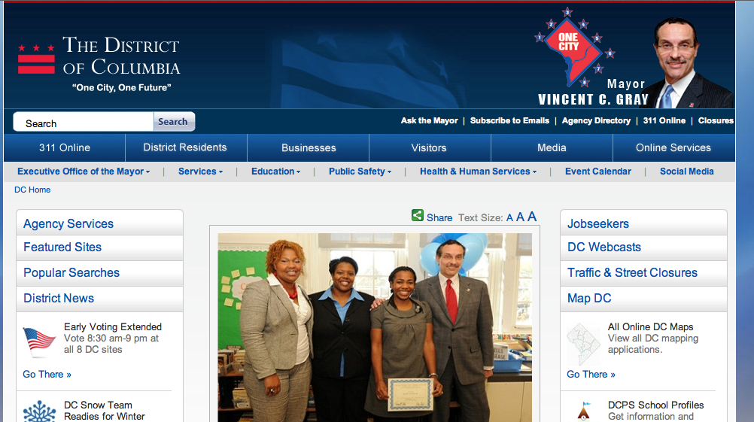
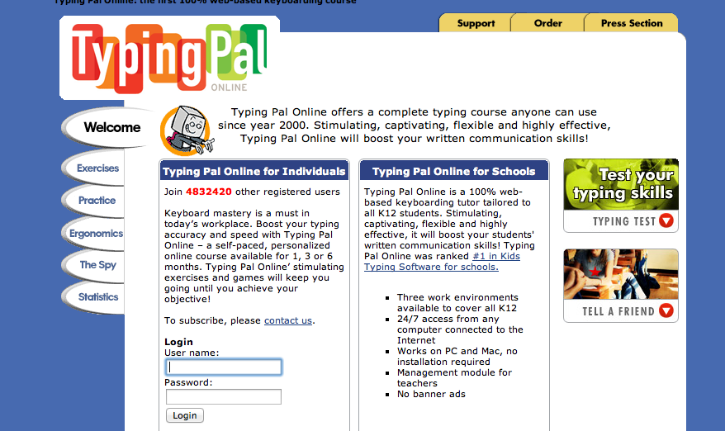
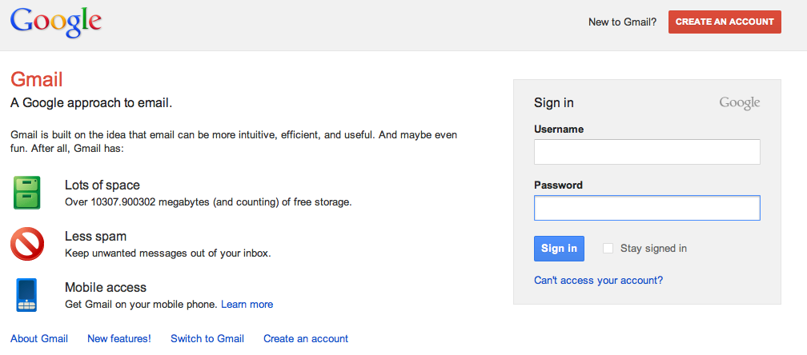
Authentic Outcomes - Internet
Every day
  Class website
  Typing practice online
  Email tasks
  Other interesting sites
Other projects
  Comparison shopping
  Searching for flights
  Creating a website
  Using social media
  Comparing VOIP services
  Reading news
Content and language
Comprehensible
Vocabulary
Building background
Authentic outcomes

Slide 30
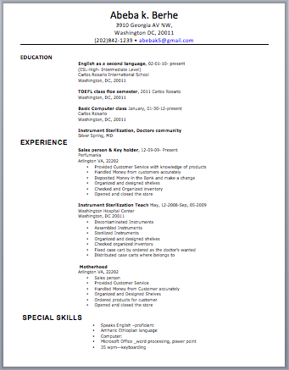
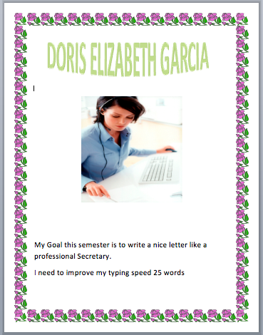
Authentic Outcomes - Word
Goals document
Advertising flyers
To do list
Pros and Cons document
Resume
Cover letter
Content and language
Comprehensible
Vocabulary
Building background
Authentic outcomes

Slide 31
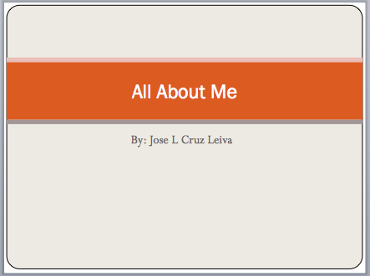
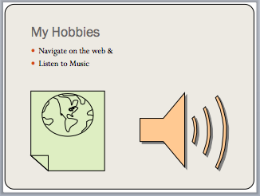
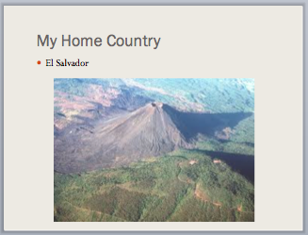
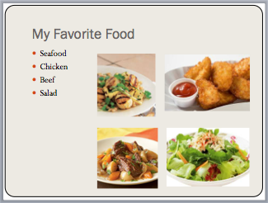
Authentic Outcomes - PPT
All about me
My home country
What I learned about…
Business plan
Content and language
Comprehensible
Vocabulary
Building background
Authentic outcomes

Slide 32
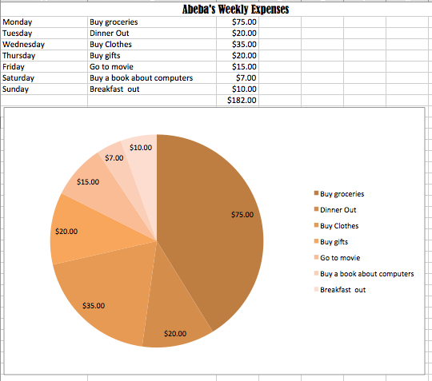
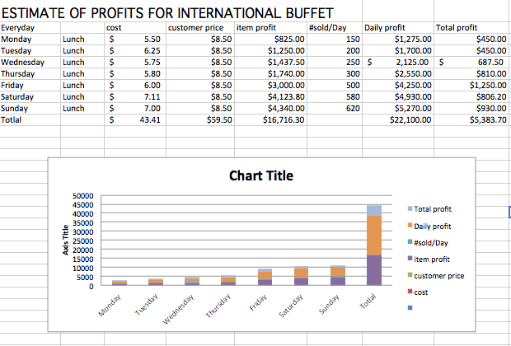
Authentic Outcomes - Excel
Expenses
Schedules
Business profits
Content and language
Comprehensible
Vocabulary
Building background
Authentic outcomes

Slide 33
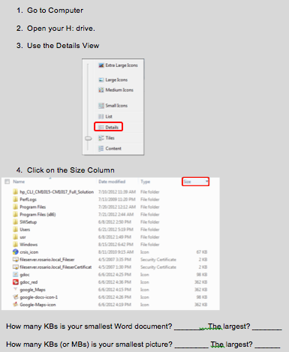
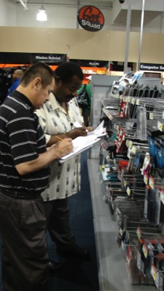
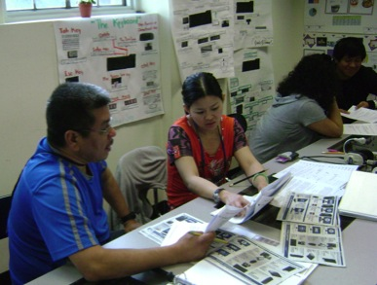
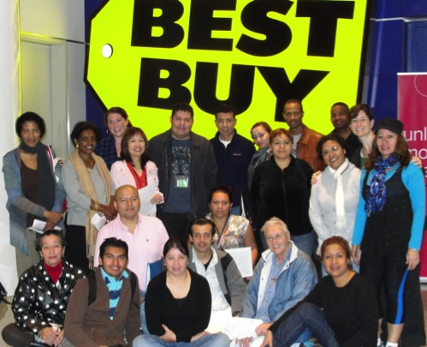
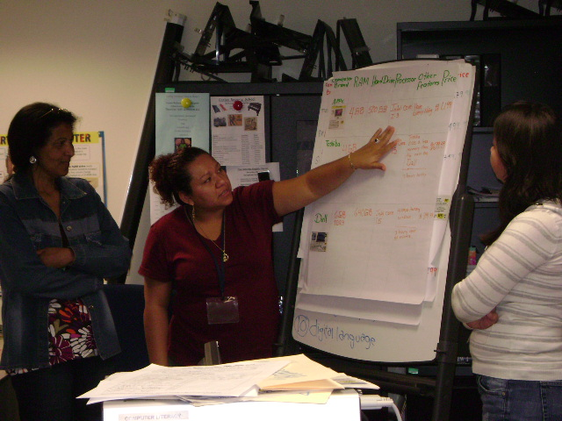
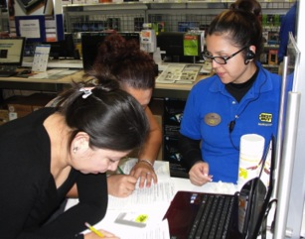
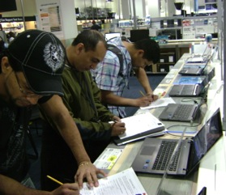
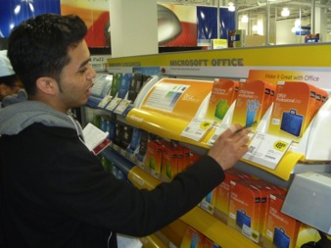
Authentic Outcomes – Digital Language
Comparison shopping in class
Shopping trip to Best Buy
Organizing files and folders by file size
Content and language
Comprehensible
Vocabulary
Building background
Authentic outcomes

Slide 34
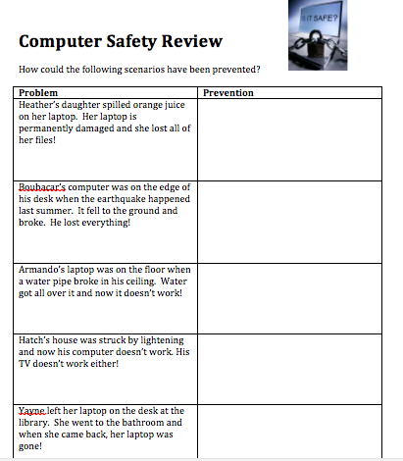
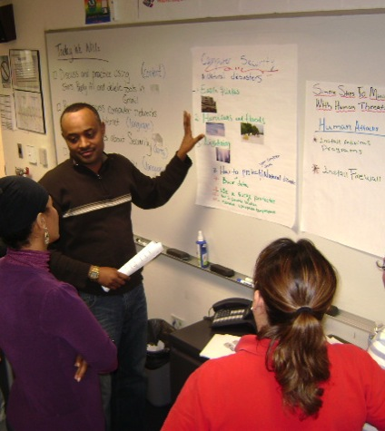
Authentic Outcomes
Computer Safety & Privacy
Advice to friends
Presenting what they’ve learned
Content and language
Comprehensible
Vocabulary
Building background
Authentic outcomes

Slide 35
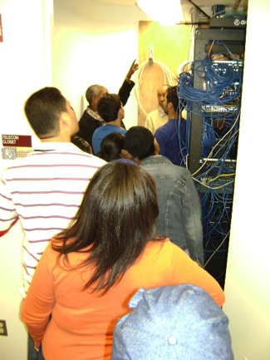
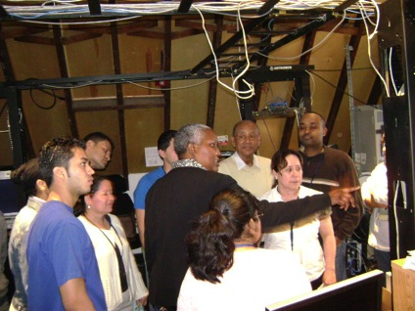
Authentic Outcomes
Computer Network & ISPs
ISP comparison shopping
Tour of school network
Content and language
Comprehensible
Vocabulary
Building background
Authentic outcomes

Slide 36
Authentic Outcomes
Final Project
Teams create a fictitious business
  Advertisement = Word
  Business plan = PPT
  Profit projections = Excel
  Menu = Word
  Research = Internet
  Website = Weebly
Abeba - http://buffeta.weebly.com/
Isam - http://dialcab.weebly.com/
Mabel http://samasfrozenyogurt.weebly.com/
Wesley - http://hotdogfishstand.weebly.com/
Yury - http://teenyweenylinguine.weebly.com/
Content and language
Comprehensible
Vocabulary
Building background
Authentic outcomes

Slide 37
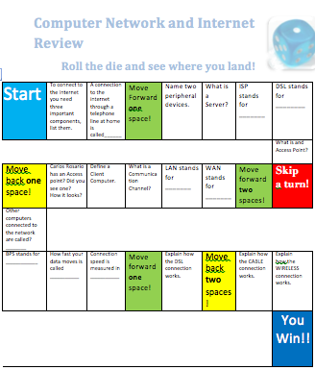
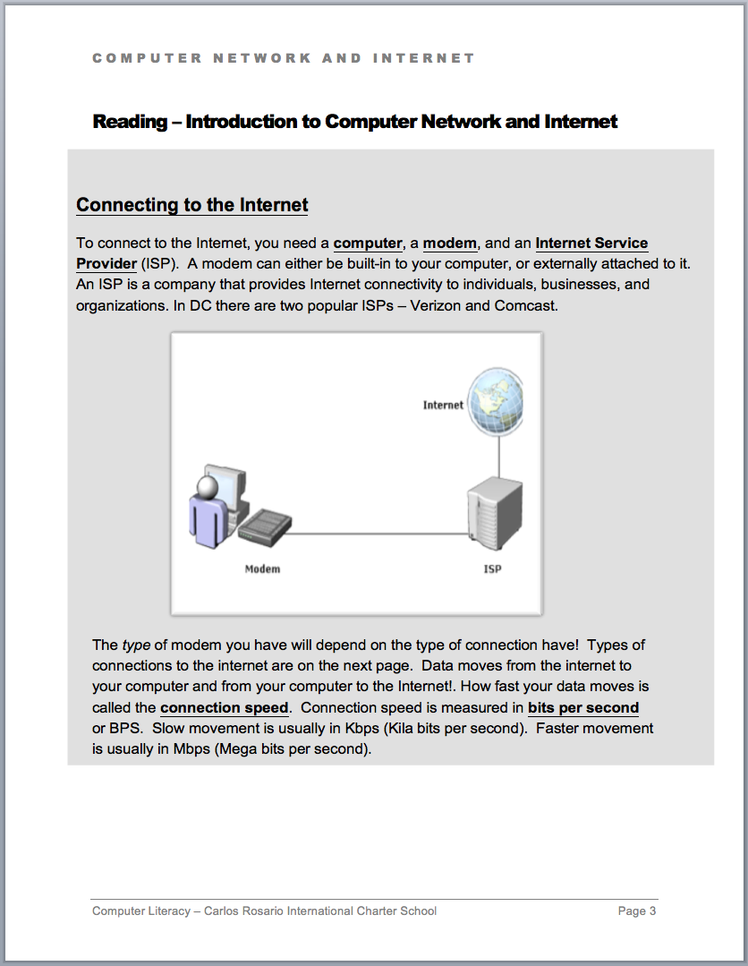
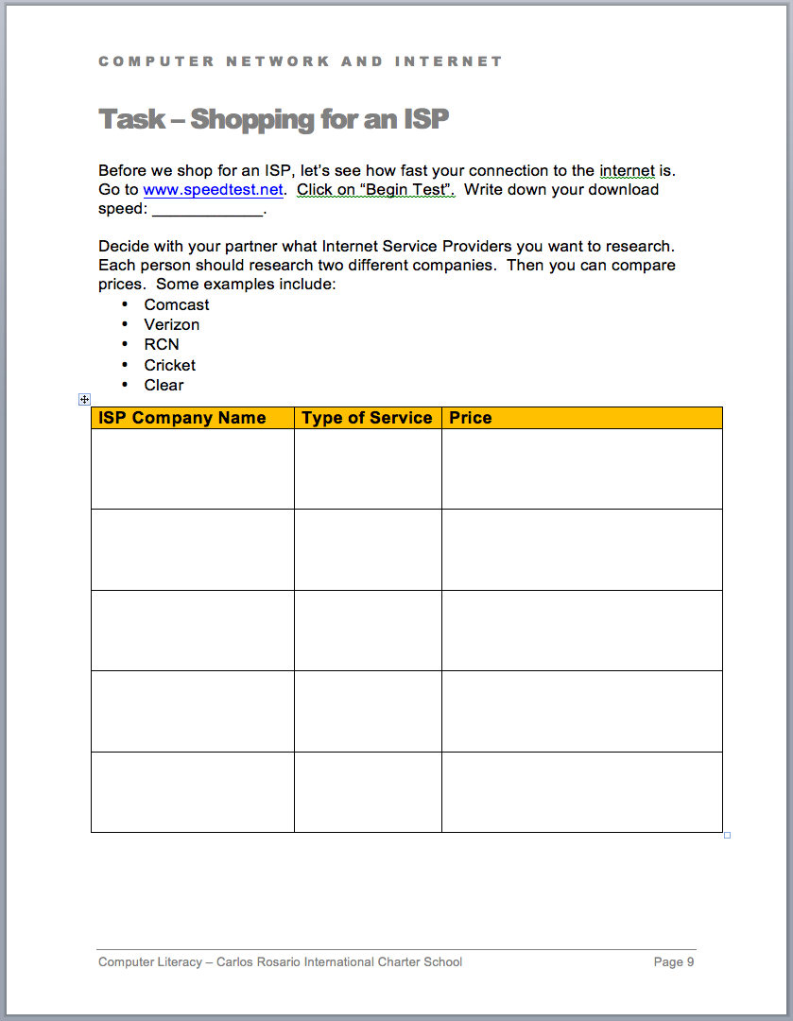
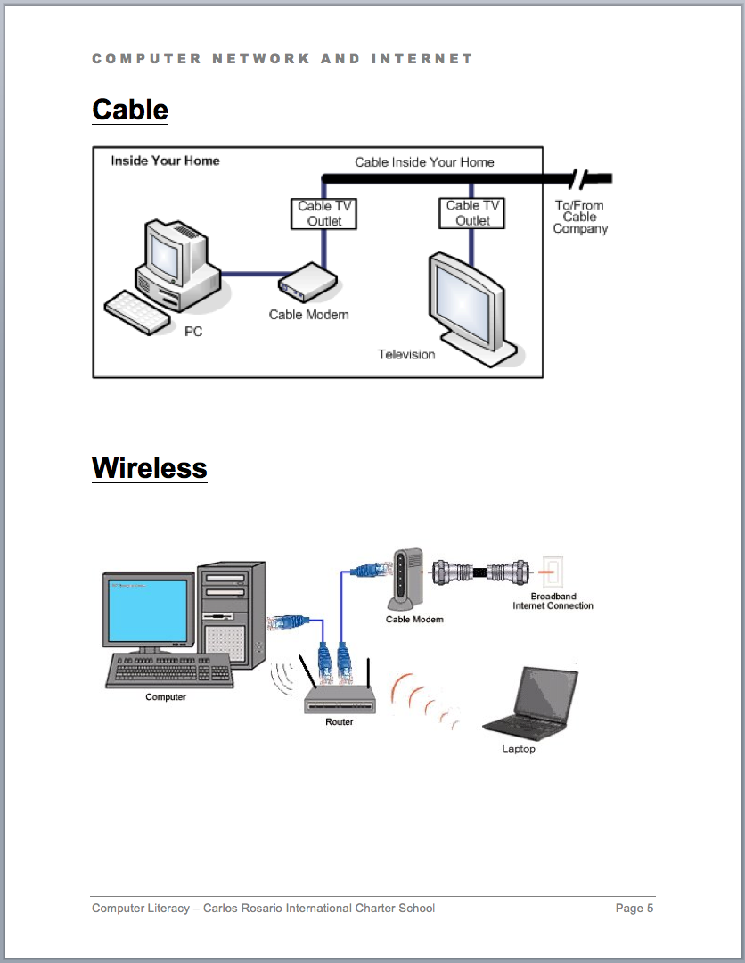
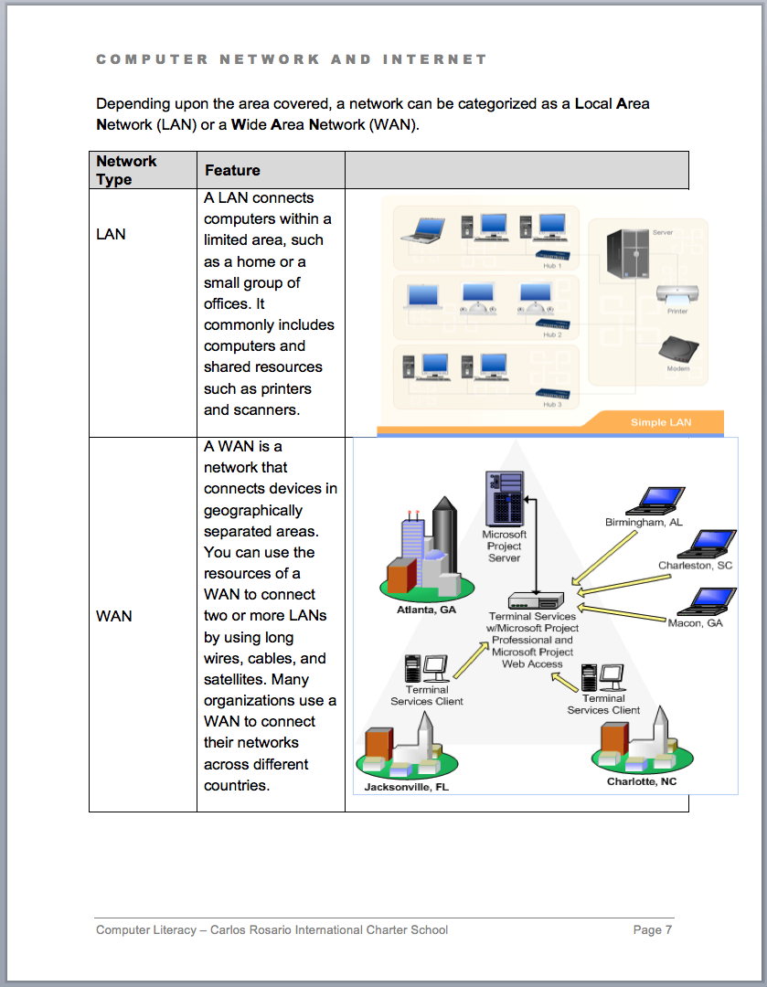
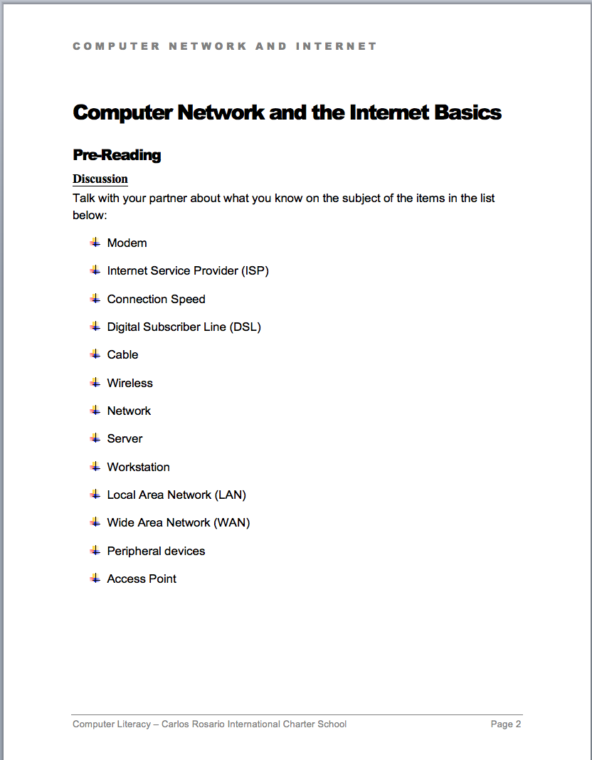
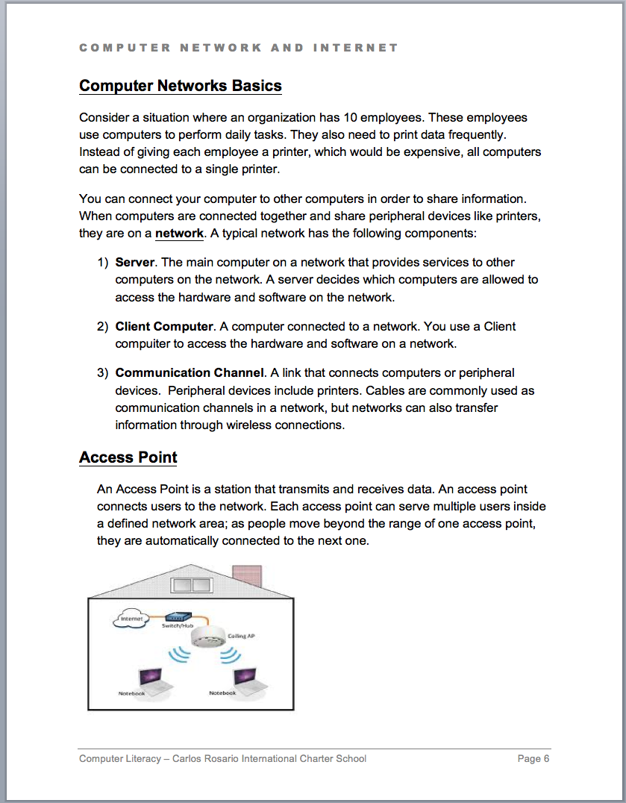
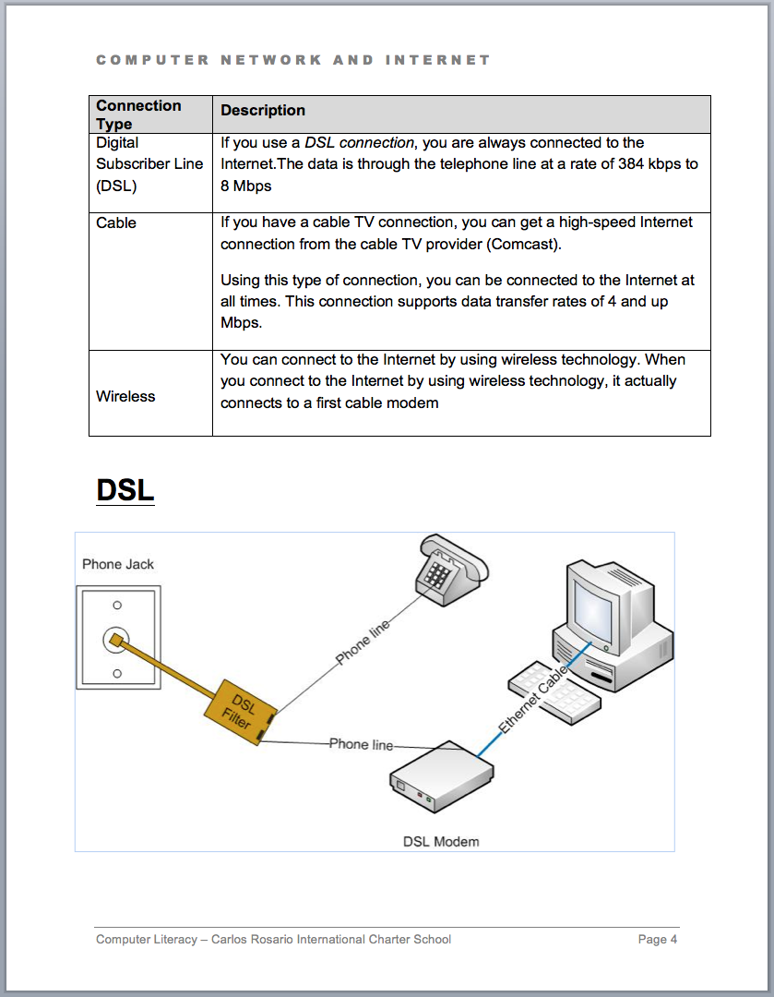
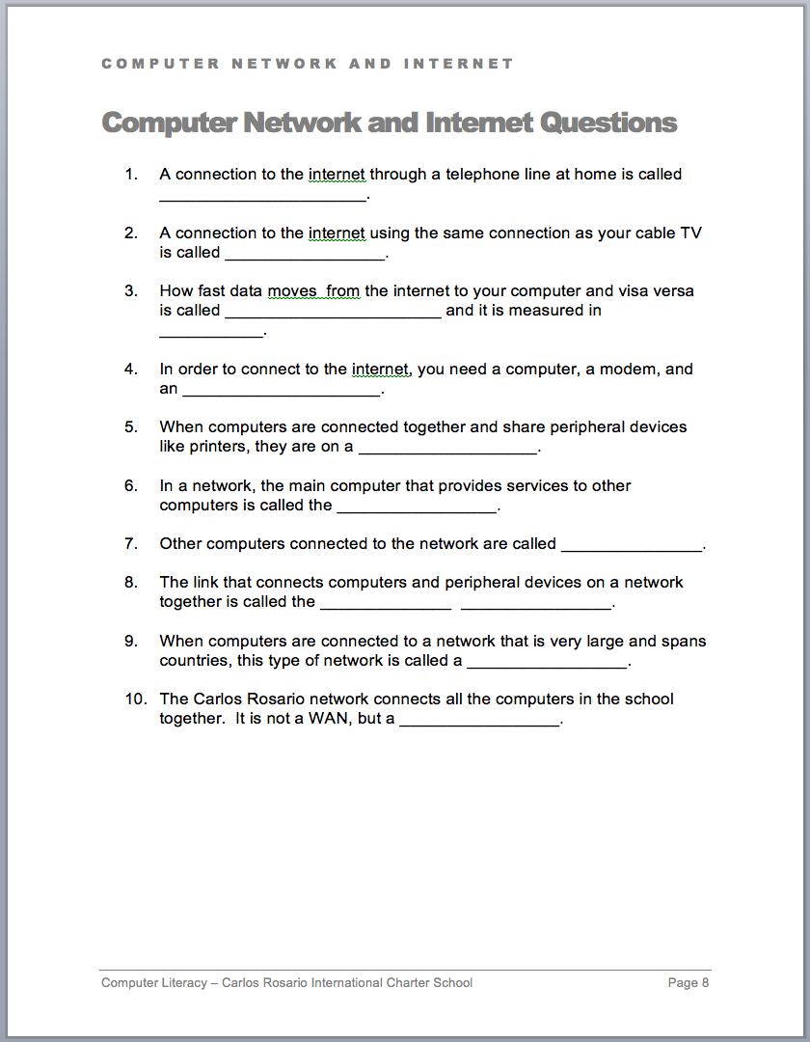
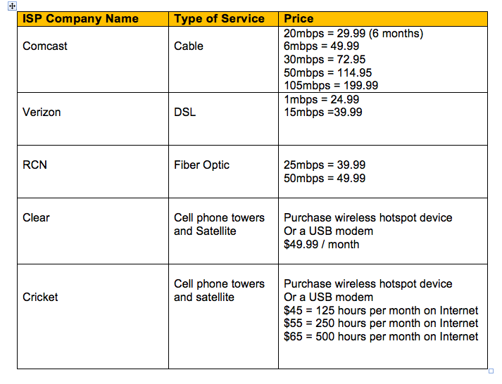
A Closer Look
www.speedtest.net
Content and language
Comprehensible
Vocabulary
Building background
Authentic outcomes

Slide 38
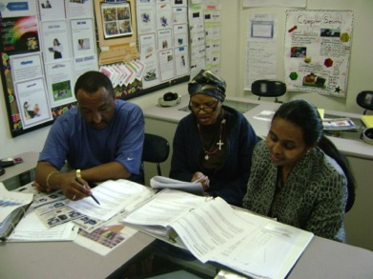
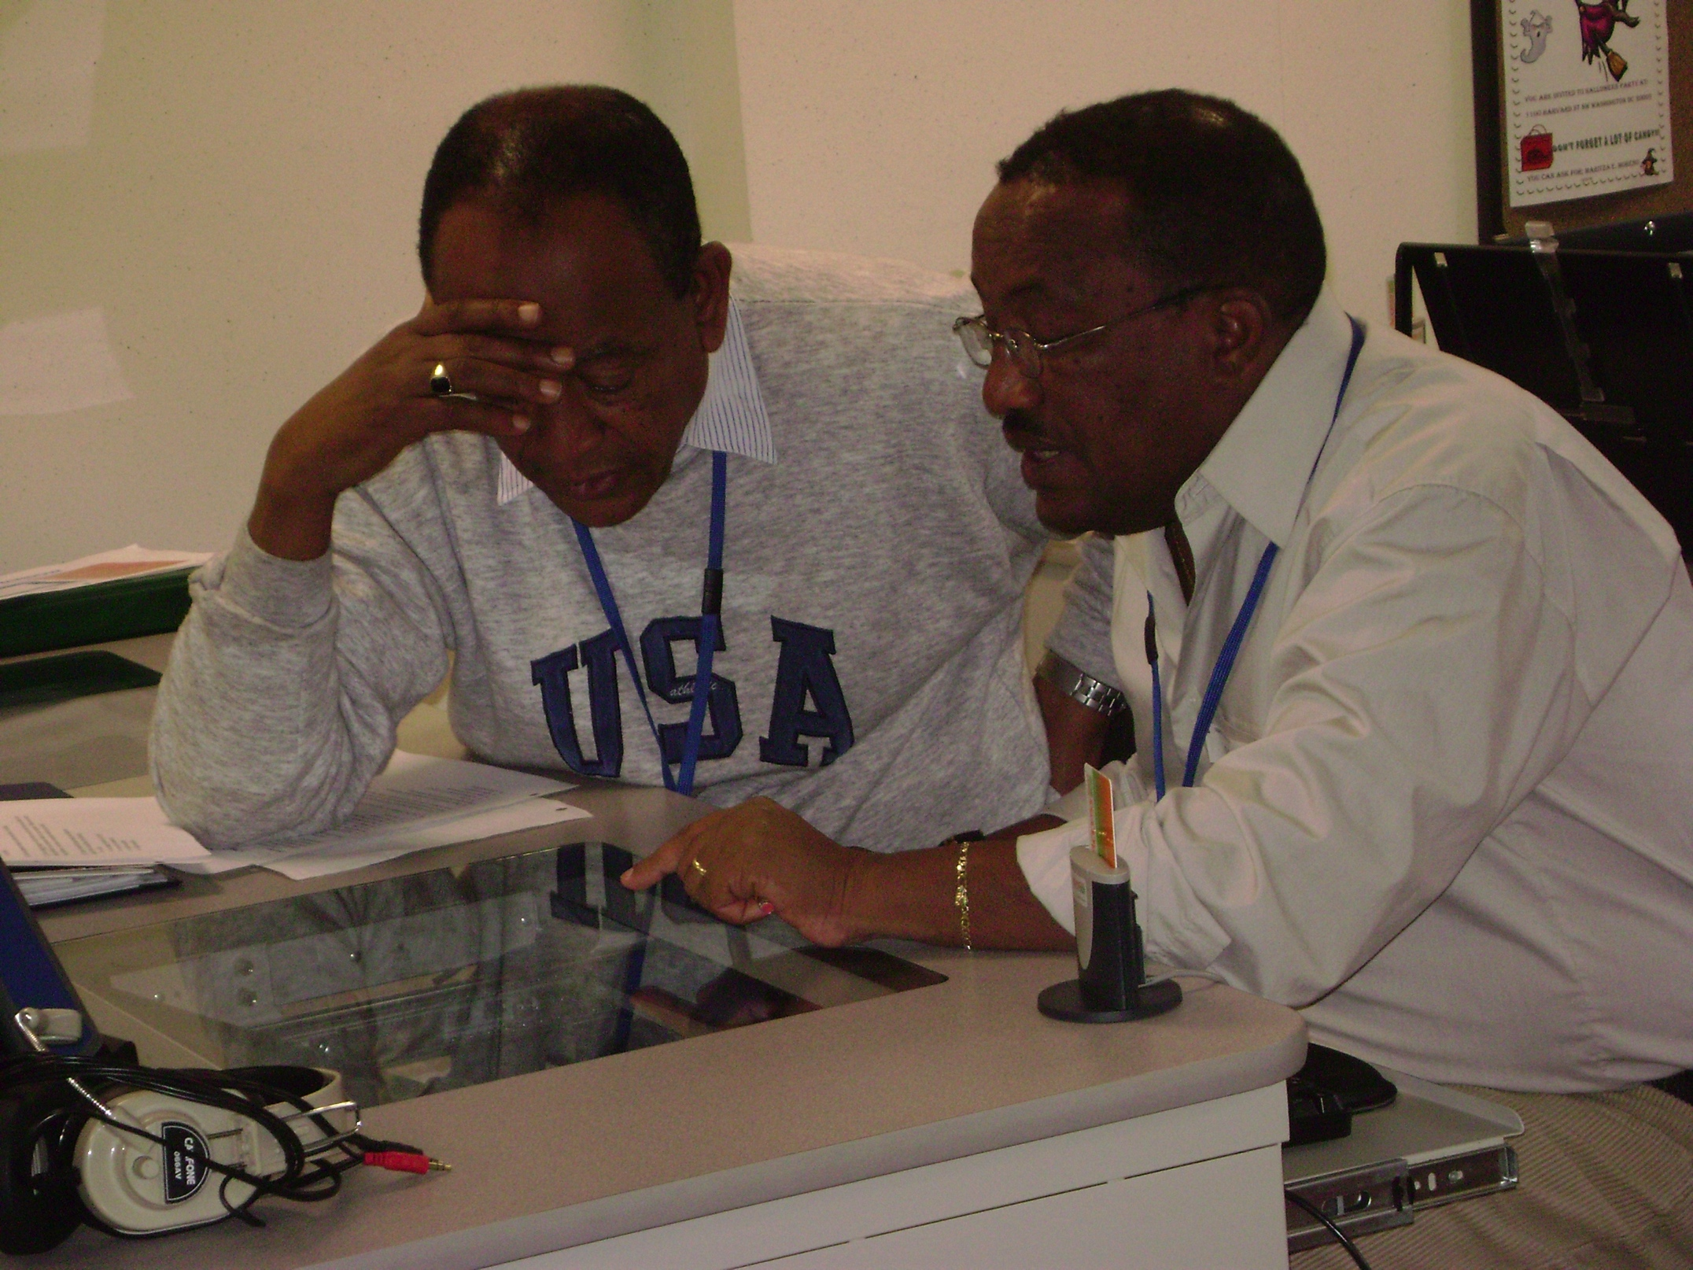
Classroom Work
Critical thinking
  Reflect on applicability to own life
  Reflect on learning goals
Peer to peer support
  Team work
Project based

Slide 39
A Closer Look at the Chapters
Hardware
Keyboard
Software / OS
Internet
Email & etiquette
Word
PPT
Excel
Job searching
Digital language
Connecting to the Internet
Computer safety
Computer privacy
Social media
VOIP
Creating a website

Slide 40
Conclusion
Sheltered instruction basics
Computer Literacy at CRPCS
Materials developed with SIOP fundamentals

Slide 41
Questions?
Website: www.carlosrosario.org
Heather Tatton, Instructor
hharris@carlosrosario.org
Miriam Burt, CAL Adult ESL Content Specialist
mburt@cal.org

