Slide 1
Computer Literacy Curriculum A First Literacy Lab Sharing
Neela Jayaraman, teamcomplit.weebly.com
10/3/2014

Slide 2
Agenda
Background / Context to project
Description of project
Learner Feedback
Assessment & Evaluation
Reflection & Adaptation
Next steps

Slide 3
TeamCompLit Background
History & collaboration
Guiding Principles
Ultimate Objective: Technology becomes an integrated part of students’ lives!
Key Instructional Strategies
Notes:
The Guiding Principles that drive the creation of materials are,
Students will be able to (SWBAT):
Use the Internet for communication and finding information
Be safe in a digital environment (this includes privacy, safety, digital footprint)
Use software that is meaningful to their lives and helpful for their future
Be informed technology consumers
Gain efficiency and confidence
Instructional Strategies embedded in the materials
Make connections (prior learning, background knowledge)
you do (exploration), I do, we do, you do – repetition
Situated within students’ experience (personalization)
Cooperative, project-based experience
Language – elaborated and scaffolded

Slide 4
Unit Components
Student Handouts
Clearly Written objectives
Vocabulary (and Building Background)
Guided exploration
Authentic tasks
Assessment
Supplementary Online Materials
Instructional videos
Online vocabulary review – Quizlet
Existing online resources

Slide 5
Unit Components
Teacher’s Guide
NRS / SPL levels
Timeframe for entire unit
Assumptions
Instructional Strategies
Metaphor suggestions
Exit ticket ideas & additional tasks
In editable word format and online to use directly from web

Slide 6
First Literacy Project
Created 2 Units
Email – Spam
Google Drive: Spreadsheet
teamcomplit.weebly.com

Slide 7
Learner Feedback
“The exact image (on the printout) of what is on the computer screen is very helpful.”
“This unit made me interesting and happiness.”
“Useful for my budget.”
“continuing teaching with the other folders likes: spreadsheet, form ...”
“Evrything you can teach”
“Drive Document”; “phishing”
“Because it explains the definitions to me and build up my knowledge about these harms to my computer.”

Slide 8
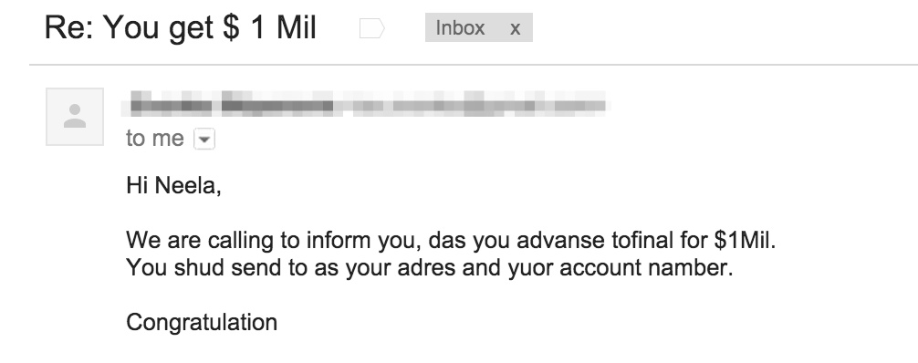
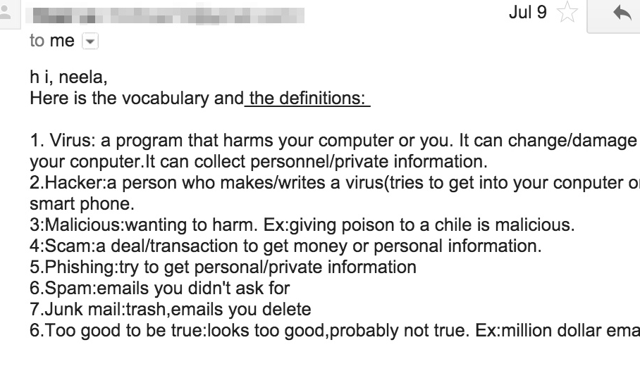
Student Work & Evaluation
Notes:
90% of students shared that they have consistently struggled to take notes / remember content during digital literacy lessons.
Every single student stated in their own words that they had learned a lot using these units and were eager to learn more!

Slide 9
Reflection
What worked? / Things to do again
What didn’t? / Things to do differently
Notes:
Getting Student Feedback difficult, especially low levels
More detailed, section-by-section instructions in Teacher’s Guide in Spam unit
Resources, ideas and technology tools added to website
Assessment recommendations and samples also on website
Timing constraints

Slide 10
Next Steps
Feedback from teachers, program directors/coordinators!
Create more units – requests at lower skill levels
Add to Tech Toolbox (teamcomplit.weebly.com)
Add to Resource & Idea Bank (teamcomplit.weebly.com)

Slide 11
Participant Feedback
Thoughts / ideas

Slide 12
Thank you!
Teamcomplit.weebly.com
teamcomplit@gmail.com

