Slide 1
Computer Literacy Instructional Resources for Adult ELLs
Lindsey Crifasi, Kristy Stoesz, Heather Tatton-Harris
Carlos Rosario International Public Charter School
TESOL - March 27, 2015

Slide 2
Raise Your Hand If…
Computer Literacy/Lab instructor
Adult ESL instructor
Administrator
ABE/GED instructor
Family Literacy instructor
Workforce/Workplace instructor
None of the above…

Slide 3
Learning about new technology…

Slide 4
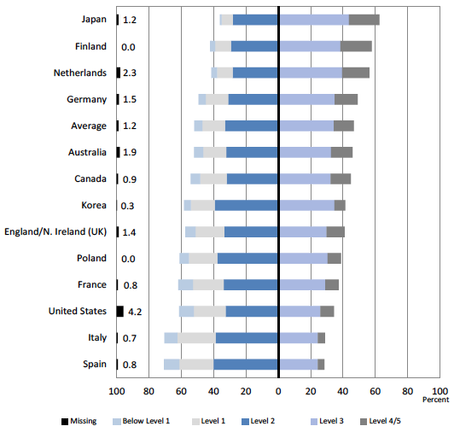
Problem Solving in Technology Rich Environments
Program for International Assessment of Adult Competencies
OECD 2013: Skills Outlook, p. 87
Notes:
Heather

Slide 5
PSTRE: Adult Immigrants
Lvl | Description | All | Immigrants
< 1 | One function | 18%
1 | Little or no navigation required Ex: Sorting emails into pre-existing folders | 60%
2 | Navigation across pages and applications Multiple steps & integration of programs Ex: Sort information in a spreadsheet and send info via email | 34%
3 | Numerous steps, processes, navigation Evaluate the relevance, reliability of information Ex: Solve scheduling problem with a room reservation system application and email a reservation request denial | 7%
42%
39%
22%
2%
Goodman et al (2013), p. 15
Notes:
Heather

Slide 6
Turn & Talk
What digital literacy challenges do you need to address in your program?
https://todaysmeet.com/complit

Slide 7
Objectives
Background and Rationale

Slide 8
Objectives
Background and Rationale
Instructional strategies

Slide 9
Objectives
Background and Rationale
Instructional strategies
Example lesson & lesson components

Slide 10
Objectives
Background and Rationale
Instructional strategies
Example lesson & lesson components
Create a Lesson for Your Program

Slide 11
Overview of Carlos Rosario Intl. Public Charter School
Began in 1970 as the community based organization, Program of English Instruction for Latin Americans (PEILA).
Became the first adult education public charter school in the nation in 1998.
Has served over 60,000 immigrants during its 42 years of operation.

Slide 12
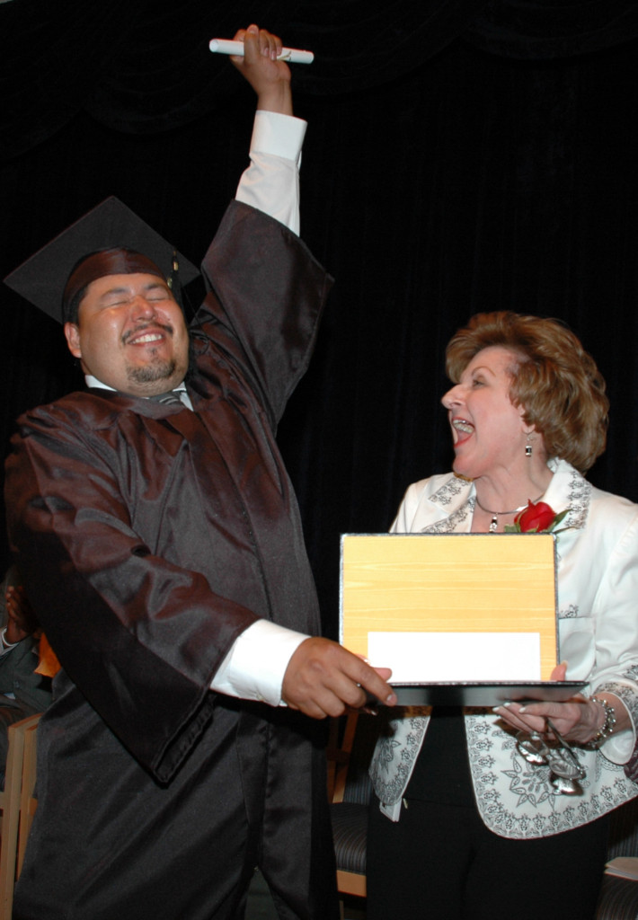
The CR Mission
Our mission is to provide education that prepares the diverse adult immigrant population of Washington D.C. to become invested, productive citizens and members of American society who give back to family and community.

Slide 13
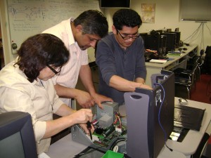
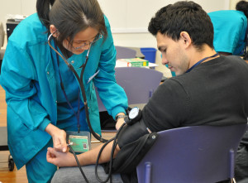
Overview of Carlos Rosario PCS
Currently serving 2,200 diverse students through a holistic, three pronged model:
Foundational Skills and Literacy
Basic Literacy
ESL
GED
Citizenship
Computer Literacy
Workforce Development Training
Culinary Arts and Servsafe
Computer Support Specialist (CSS)
Nurse Aide Training
Comprehensive Supportive Service

Slide 14
Student Profiles – Years of Education

Slide 15
Student Profiles – 1st Languages

Slide 16
Student Profiles – Age Ranges

Slide 17
Digital Literacy Instruction for ELLs
20-35 students per class
ESL classes come to the lab once every 6-10 school days
Grouped by English level, not computer level
ESL Orientation A (Pre-literate/Pre-ESL) to 8 (Low Advanced ESL) (National Reporting Standards)
ESL teacher and Dig Lit teacher meet before Dig Lit class to co-plan
Notes:
Lindsey

Slide 18
Instructional Strategies
Make connections (prior learning, background knowledge)
You do, I do, we do, you do – repetition
Situated within students’ experience (personalization)
Cooperative, project-based experience
Problem Solving in Technology Rich Environments (PSTRE)
Language – elaborated and scaffolded
Notes:
Lindsey
As ESL instructors, we knew that we had to apply what we know about learning language to learning technology. Those same principles of learning are fundamental in acquiring digital literacy. As such, we start with making connections to background knowledge and prior learning. Ex: when we introduce PPT, we have students look at the ribbon and tools; what tools do they see that they’ve already learned in MS Word? What do they already know about PPT? When we introduce learning how to buy a computer or a smartphone, what do they already know about that? Our students bring a surprising amount of knowledge with them to the classroom – tap into that.
Second – Risk taking. As in learning language, we have to be comfortable taking risks and gaining confidence in taking risks. I do, we do, you do is the typical instructional sequence. What we are proposing, however, is having the students “do” some exploration before instruction begins. Ex: when we are teaching email. In pairs, have students move the mouse around the gmail screen: what do they see? What do they think “To” means? What is the “subject” box for? “What do we do with the “Compose” button? We call this “Guided Exploration” because we point students to specific questions to think about and make predictions about. Learning to use technology is a lot like reading and listening. We have to make some predictions and monitor our understanding of how technology works as we move through the process of using it! These are the same metacognitive skills that we use with reading, writing, listening and speaking.
Third – Personalizing the tasks make all the difference. The way we present technology must be immediately applicable to their lives. As such, we take care to contextualize everything that we teach so that it’s relevant.
Fourth – Every task we do, we encourage peer support. Students build community and confidence through that approach. Exploring new technology isn’t so scary when you do it with a friend! In addition, every task is a real-life project.
5 – the language used in the handouts is not watered down. We use the words they need to learn by pre-teaching the vocabulary and providing elaborated language where words are challenging.

Slide 19
Guiding Principles
Use the Internet for communication and finding information
Be safe and smart in a digital environment
Use software that is meaningful to their lives and helpful for their future
Be informed technology consumers
Gain efficiency and confidence
Ultimate Objective:
Technology becomes an integrated part of their lives!

Slide 20
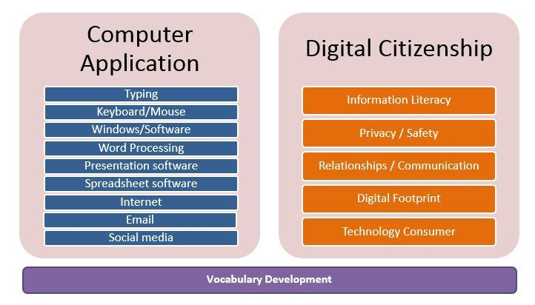
Guiding Principles

Slide 21
Lesson Outline
Objectives | What do you want your students to be able to do independently after the lesson?
Activate Background Knowledge | What do your students already know? How can you elicit that thinking?
Vocabulary | What words do they need to know?
Guided Exploration | What do you want them to try on their own first?
Authentic Tasks | What steps are important to highlight? And what real-life project will they do?
Repeat & Remember | What vocabulary/concepts will they review? Discuss how they will use in their real life.
Follow-Up Tasks | What follow-up will you do? What task can they do to practice and reinforce learning?

Slide 22
Lesson Example #1
Level 2 – NRS High Beginning
Formal & Informal Communication via Email
Digital Citizenship Lesson

Slide 23
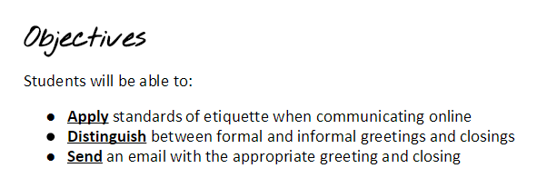
Communication
Formal vs Informal Greetings and Closings
Written in terms of what students will learn or do
Stated simply
Measurable

Slide 24
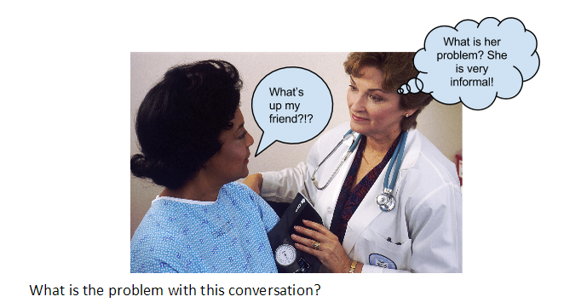
Before Lab: Activate Background
Connect the ESL classroom with the computer lab
ESL teacher introduces the topic to students through a discussion

Slide 25
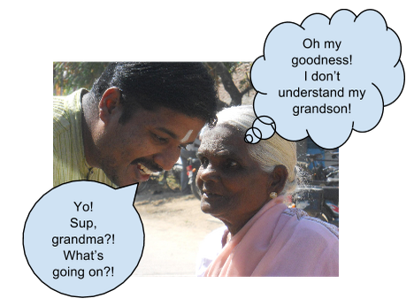
Activate Background + Vocab.
Connecting to the new content
From personal experience
From prior lessons

Slide 26
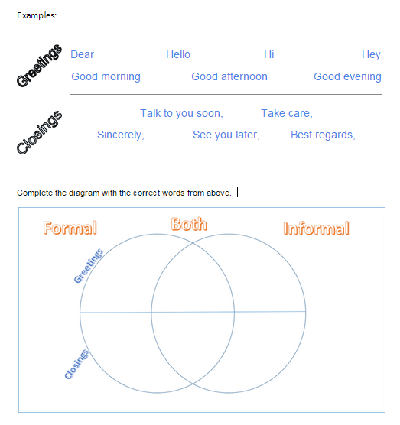
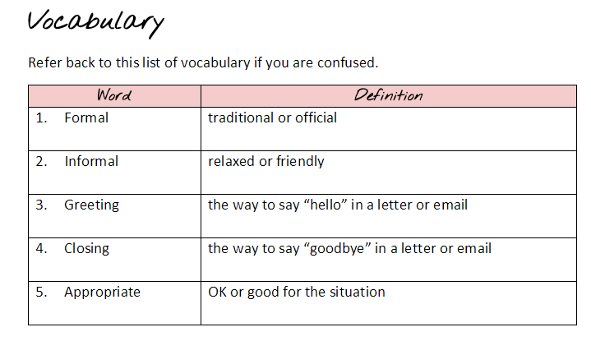
Vocabulary
Introducing vocabulary

Slide 27
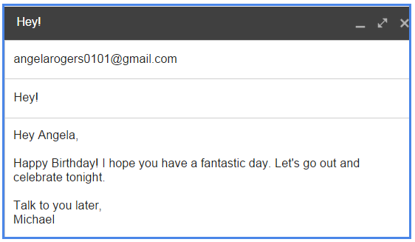
Guided Exploration
Gain exposure to the language
Discussion with a partner

Slide 28
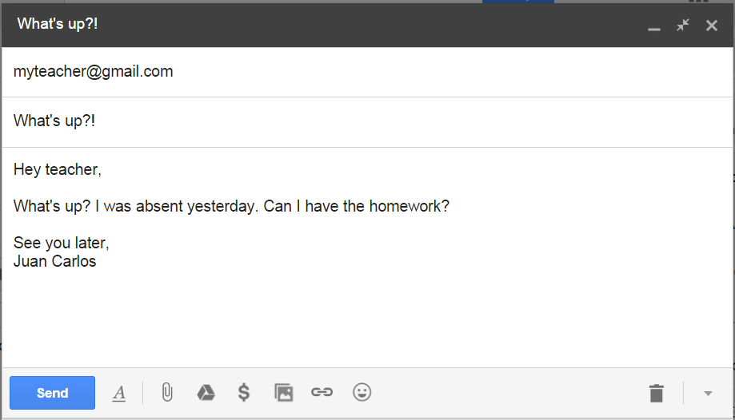
Guided Exploration
Finding the problems together
Peer collaboration

Slide 29
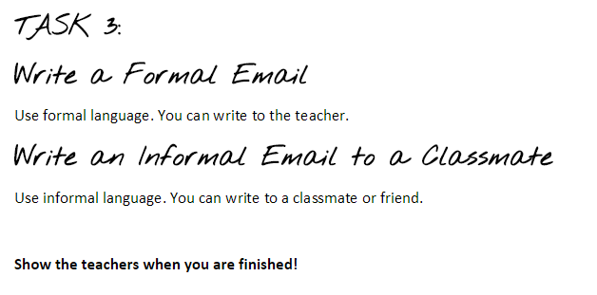
Authentic Task
Students put what they learned into practice
Formative assessment is a real-life task
Students are encouraged to work together

Slide 30
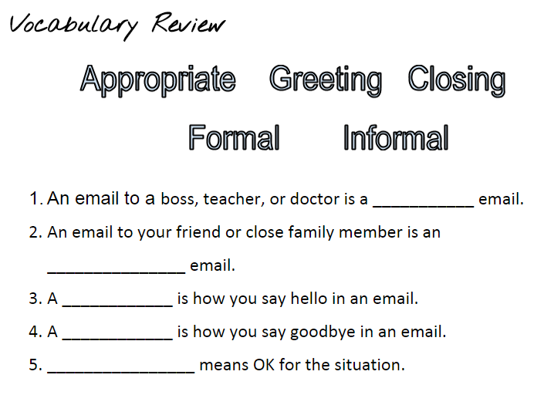
Repeat & Remember
Discussion to wrap up
Circle back to original vocabulary

Slide 31
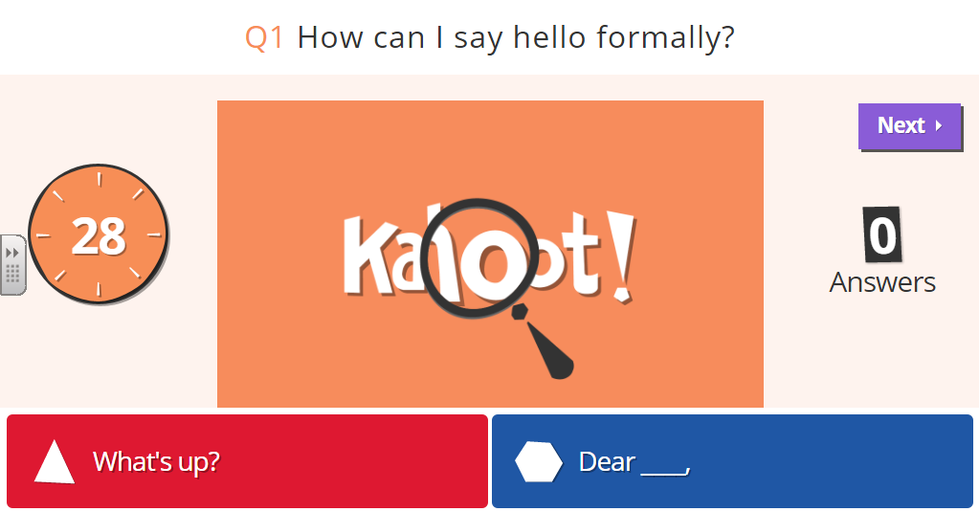
Repeat & Remember: Formative Assessment
Can be for a review in the following class
Game-based evaluation
Instant feedback for you and the students

Slide 32
Lesson Example #2
Level 7 – NRS Advanced (or Low Advanced)
Obj Strand Digital Literacy Topic Environment Objective
7-T1 | Computer Application | Presentation Software | Slide basics | MS PPT | Create a PowerPoint Presentation, add slides, move slides, change slide layout, insert pictures and clip art, Insert text box, change theme, present slide show
7-T2 | Computer Application | Presentation Software | Slide basics | Internet: Google Drive | Create a Google Presentation (comparing features to MS PPT)
7-T3 | Computer Application | File Organization | Files/ Folders | Windows | Create Folders, expand and collapse
7-T4 | Computer Application | Word Processing | Searching/shortcut | MS Word | Use "Find" (Ctrl F) to search in a document
7-T5 | Computer Application | Internet use | Searching/shortcut | Internet: Browser | Use "Find" (Ctrl F) and other strategies to search within a website for specific information
7-T6 | Computer Application | Internet use | Online resources | Internet: Browser | Use online translators and dictionaries to evaluate meanings of new words
7-T7 | Computer Application | Internet use | Searching | Internet: Browser | Use filter options to refine searches in a website
7-T8 | Computer Application | Internet Use | Safety | Internet: Browser | Identify elements of safe websites
7-T9 | Computer Application | Email | Sending links | Internet: Gmail | Copy/Paste a website link into an email
7-T10 | Digital Citizenship | Technology consumer | Technology features | Internet: Browser | Evaluate affordable computers to fit needs by using hardware and software features (hard drive, RAM, processor, screen size)
7-T11 | Digital Citizenship | Technology consumer | Social ratings | Internet: Browser | Use online consumer ratings to evaluate whether or not to purchase an item
7-T12 | Digital Citizenship | Information Literacy | Searching | Internet: Browser | Evaluate and master new strategies for effective and efficient online searches
7-T13 | Digital Citizenship | Privacy/ Safety | Safety | Internet: Browser | Evaluate whether it is safe to shop online
7-T14 | Digital Citizenship | Relation/ Comm | Safety | Internet: Browser | Evaluate if a relationship online is safe
Notes:
Kristy

Slide 33
Objectives
Stated simply
Written in terms of what students will learn or do

Slide 34
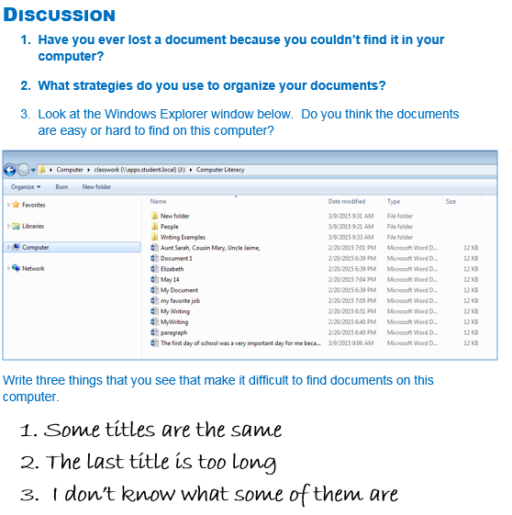
Activate Background
Connecting to the new content
From personal experience
From prior lessons
Introducing vocabulary
Exploring to learn

Slide 35
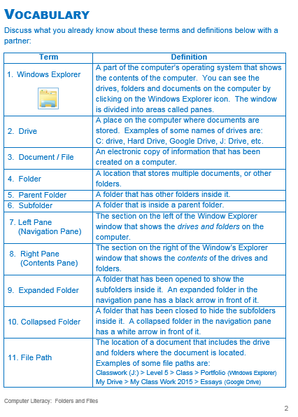
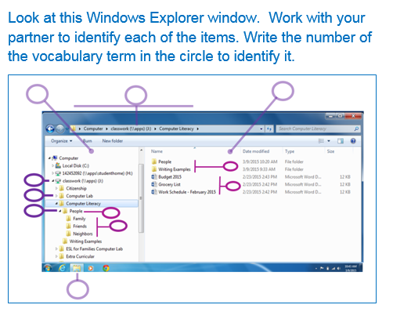
Activate Background + Vocab.

Slide 36
Guided Exploration
Peer collaboration
Predicting function

Slide 37
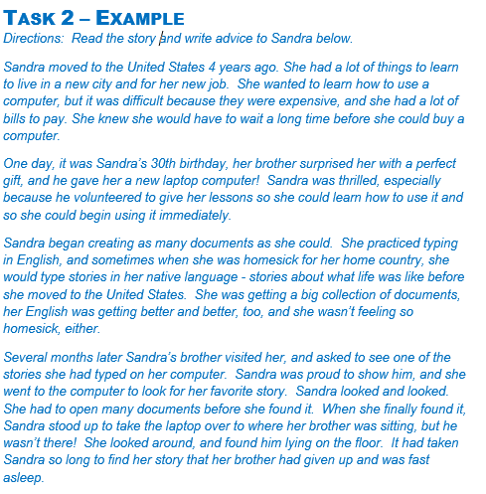
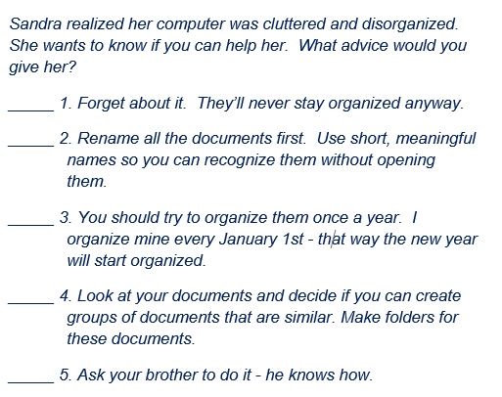
Guided Exploration
Peer collaboration
Predicting function

Slide 38
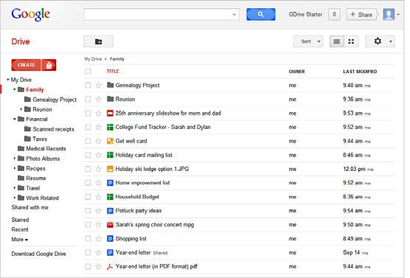
Authentic Task
Step-by-step instructions
Image of outcome

Slide 39
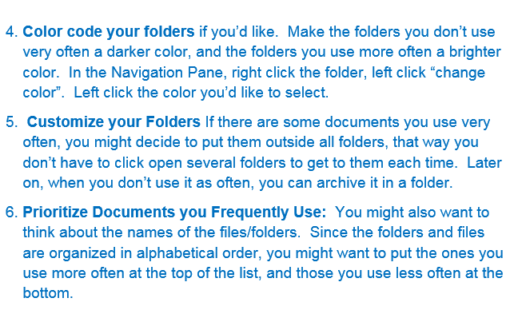
Authentic Task
Contextualization
Personalization increases motivation
Engagement
Amount learned
Perceived competence and levels of aspiration

Slide 40
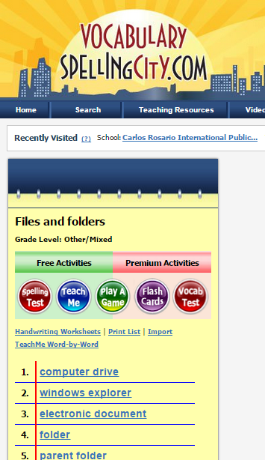
Repeat & Remember
Circle back to original vocabulary

Slide 41
Big Ideas + Real Life
Circle back to the Objectives
Discuss how S plans to use this technology in his/her life.

Slide 42
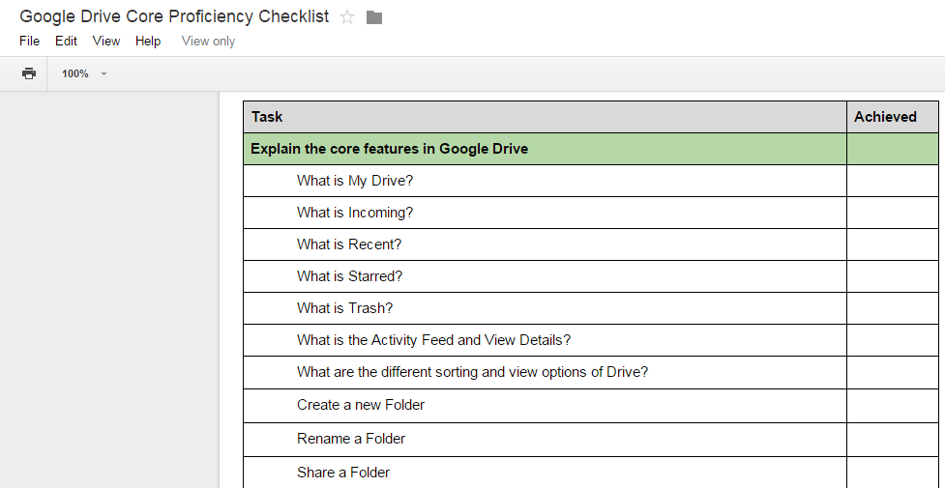
Follow-Up Tasks
Tasks to do on their own

Slide 43
Lesson Components
Student Handout
Objectives
Activate Background & Vocabulary
Guided Exploration
Authentic Tasks
Assessment
Repeat & Remember
Connections to real life
Follow-up

Slide 44
Lesson Accessories
Screencasts (screencast-o-matic)
Online quizzes
Quizlet
Quia
Spelling City
Connections to existing resources
GCF Learn Free (gcflearnfree.org)
Digital Learn (digitallearn.org)
Resources on our website
www.teamcomplit.weebly.com
Notes:
Integrate into Handout

Slide 45
Create Your Lesson

Slide 46
What Lessons Do Your Ss Need?
Create an outline for your lesson including:
Objectives | What do you want your students to be able to do independently after the lesson?
Activate Background Knowledge | What do your students already know? How can you elicit that thinking?
Vocabulary | What words do they need to know?
Guided Exploration | What do you want them to try on their own first?
Authentic Tasks | What steps are important to highlight? And what real-life project will they do?
Repeat & Remember | What vocabulary/concepts will they review? Discuss how they will use in their real life.
Follow-Up Tasks | What follow-up will you do? What task can they do to practice and reinforce learning?

Slide 47
Use Padlet to Reflect
Padlet.com/teacherlindseyc/diglit
What Digital Literacy topic did you choose to do and why?
What was interesting to you about using this lesson flow with your topic?

Slide 48
References
Cordova & Lepper, 1996. Intrinsic motivation and the process of learning: Beneficial effects of contextualization, personalization, and choice. Journal of Educational Psychology, Vol 88(4), Dec 1996, 715-730.
Echevaria & Graves (2007). Sheltered content instruction: Teaching English language learners with diverse abilities. 3rd Ed. Boston: Allyn & Bacon.
Goodman, M., Finnegan, R., Mohadjer, L., Krenzke, T., and Hogan, J. (2013). Literacy, Numeracy, and Problem Solving in Technology-Rich Environments Among U.S. Adults: Results from the Program for the International Assessment of Adult Competencies 2012: First Look (NCES 2014-008). U.S. Department of Education. Washington, DC: National Center for Education Statistics. Retrieved [date] from http://nces.ed.gov/pubsearch.
OECD (2013), OECD Skills Outlook 2013: First Results from the Survey of Adult Skills, OECD Publishing. http://dx.doi.org/10.1787/9789264204256-en

Slide 49
Discussion
Heather Tatton-Harris – hharris@carlosrosario.org
Lindsey Crifasi – lcrifasi@carlosrosario.org
Kristy Stoesz – kstoesz@carlosrosario.org
www.teamcomplit.weebly.com

