Slide 1
Making Computer Literacy Meaningful
Effective Teaching Strategies & Innovative Instructional Materials For Computer Literacy Instruction
Neela Jayaraman (& Heather Tatton-Harris)
CWC Conference / May 1, 2014
www.teamcomplit.weebly.com/blog

Slide 2
Raise your hand if…
Computer Literacy/Lab instructor
Adult ESL instructor
Administrator
ABE/GED instructor
Family Literacy instructor
Workforce/Workplace instructor
None of the above…

Slide 3
Learning about new technology…
http://teamcomplit.weebly.com/
Notes:
----- Meeting Notes (3/28/14 08:46) -----
presumably we're all here because we have encountered challenges with technology instruction. Here's a video we can all relate to.

Slide 4
Discussion
What digital literacy challenges do you need to address in your program?

Slide 5
Objectives
Computer Literacy at our programs

Slide 6
Objectives
Computer Literacy at our programs
Instructional strategies

Slide 7
Objectives
Computer Literacy at our programs
Instructional strategies
Example lesson & lesson components

Slide 8
Objectives
Computer Literacy at our programs
Instructional strategies
Example lesson & lesson components
Sequencing of topics

Slide 9
Objectives
Instructional strategies
Example lesson & lesson components
Sequencing of topics
Discussion, Collaboration, Questions
Computer Literacy at our programs

Slide 10
BEST Corp. Hotel Training Center
Founded 2007
Provides education and training to the unionized staff of Boston’s 27 union hotels
Heart of the house staff
Approximately 400 students annually

Slide 11
Computer Literacy at BEST Corp.
Computer/Tech Workshops
ESL Classes & Computer Skills
4 levels, modular format
2.5 hours / once a week
1 - 4 sessions
Challenges:
Not enough students at basic and advanced levels
Work schedules
All English classes go into the Tech Center once in 2 weeks - 30-60 mts.
Challenges:
A wide spectrum of computer skills
No tech curriculum

Slide 12
Project Literacy – Watertown Library
Founded over 25 years ago
250 students annually, over 100 tutors
Computer workshops only offered at the basic level
20 students max; once a week; 2 hour sessions
11-13 weeks
Challenges:
Not enough space – waiting list
No higher levels
Only offered 1 cycle / yr – usually Feb-June

Slide 13
Instructional Strategies
Make connections (prior learning, background knowledge)
I do, we do, you do – repetition
Situated within students’ experience (personalization)
Cooperative, project-based experience
Language – elaborated and scaffolded
Notes:
----- Meeting Notes (3/28/14 08:46) -----
You know more than you think you know!
before we learn PPT, we always discuss that we already know a lot about the ribbon, tabs, and overall layout of the software

Slide 14
Guiding Principles
Use the Internet for communication and finding information
Be safe in a digital environment
Use software that is meaningful to their lives and helpful for their future
Be informed technology consumers
Gain efficiency and confidence
Ultimate Objective
Technology becomes an integrated part of their lives

Slide 15
Metaphors
Entry | Survival | Stepping Stone | Milestone
Windows desktop Programs Icons on desktop | Save vs. save as Reply vs. forward OS vs. programs | Cloud storage Google Apps | User Profiles
Entry | Survival | Stepping Stone | Milestone
Windows desktop Programs Icons on desktop | Save vs. save as Reply vs. forward OS vs. programs | Cloud storage Google Apps | User Profiles
“Through metaphors we extend our understanding.”
S. Pugh, 1989. Metaphor and Learning. Reading Research and Instruction, v. 28, 3.
Notes:
----- Meeting Notes (3/28/14 08:46) -----
15-30

Slide 16
Objectives
Stated simply
Written in terms of what students will learn or do
Echevaria & Graves (2007). Sheltered content instruction: Teaching English language learners with diverse abilities. 3rd Ed. Boston: Allyn & Bacon.

Slide 17
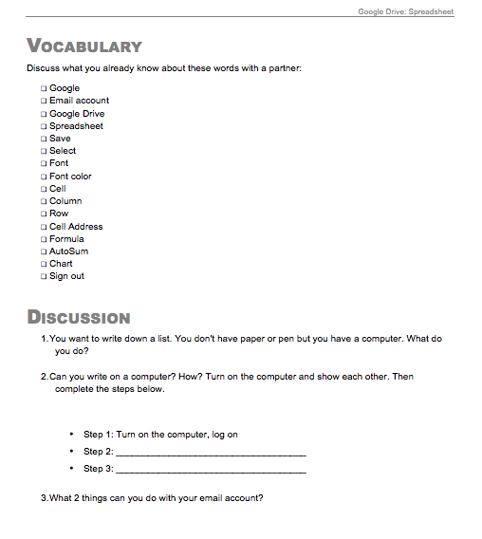
Vocabulary & Building Background
Introduce vocabulary
Connecting to the new content
From personal experience
From prior lessons
Exploring to learn

Slide 18
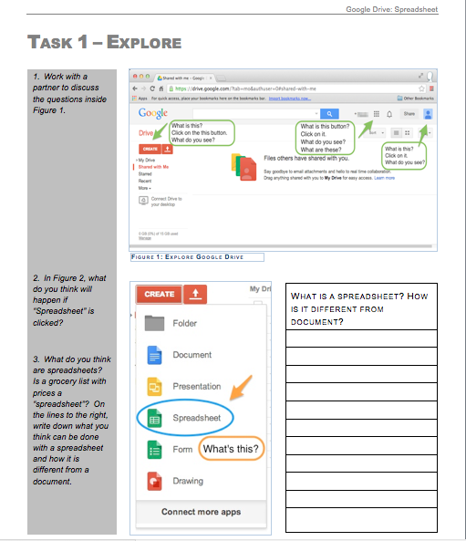
Exploring to Learn
Guided exploration
Peer collaboration
Predicting function

Slide 19
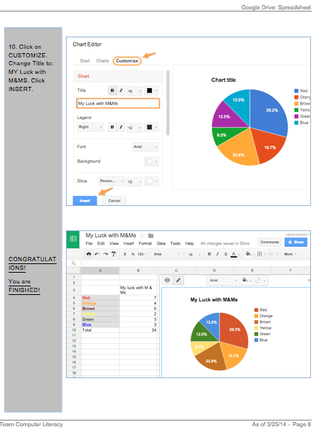
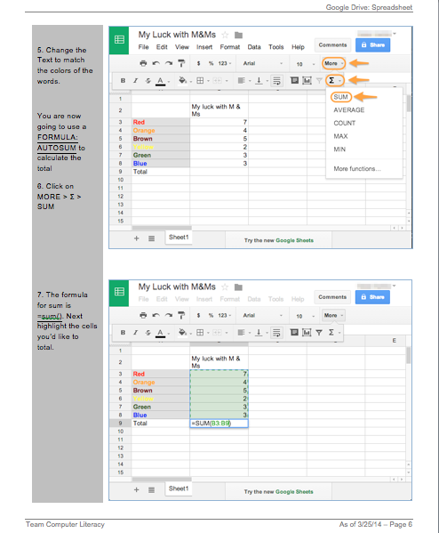
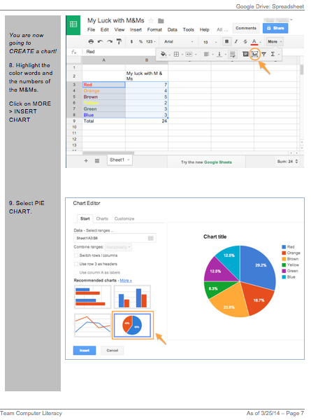
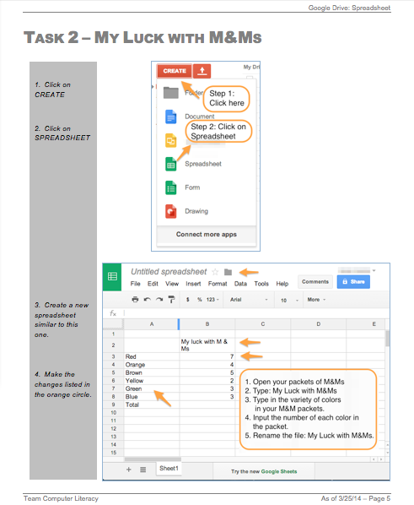
Step-by-Step
Guided step-by-step instructions
Image of outcome

Slide 20
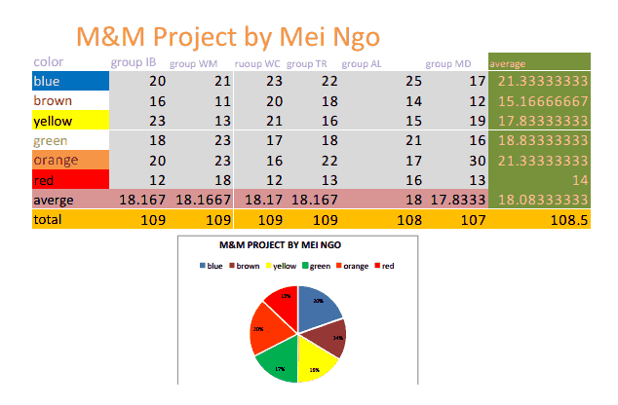
Personalized
Contextualization & personalization increases
Motivation & engagement
Amount learned
Perceived competence and levels of aspiration
Cordova & Lepper, 1996. Intrinsic motivation and the process of learning: Beneficial effects of contextualization, personalization, and choice. Journal of Educational Psychology, Vol 88(4), Dec 1996, 715-730.

Slide 21
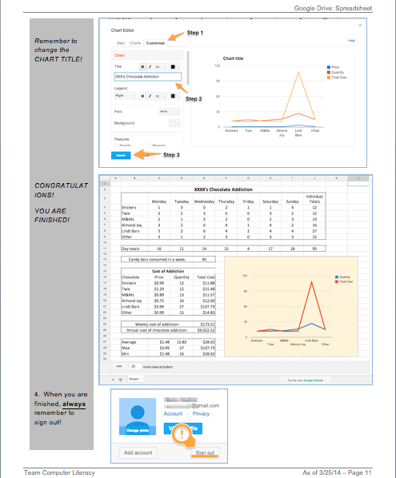
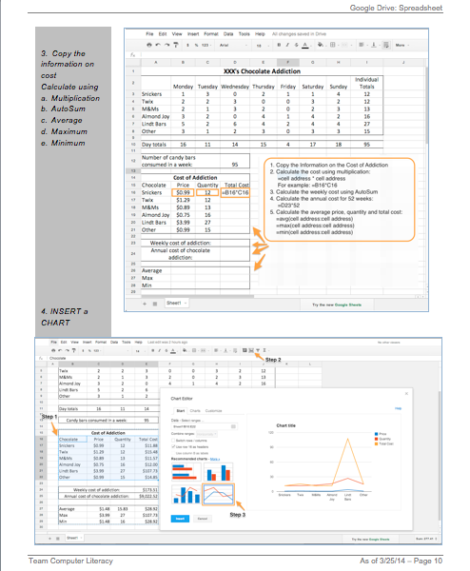
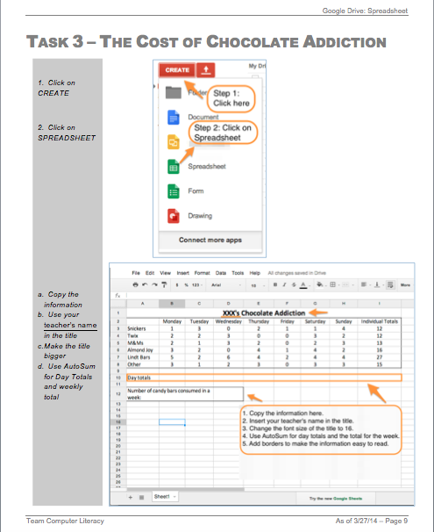
More Excel…
Made Less Intimidating
Step-by-step – not so intimidating.
More engaging - use teacher as example!
Discussion on teacher’s health and general health concerns!
Eagerness to learn more increased

Slide 22
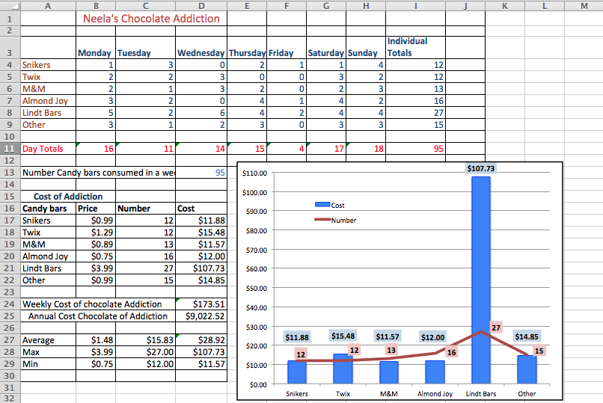

Slide 23
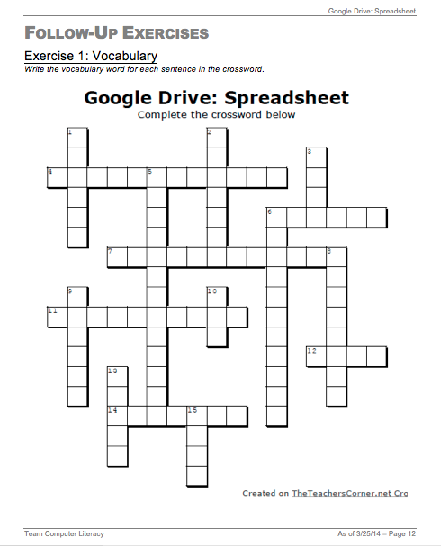
Vocabulary Review
Circle back to original vocabulary

Slide 24
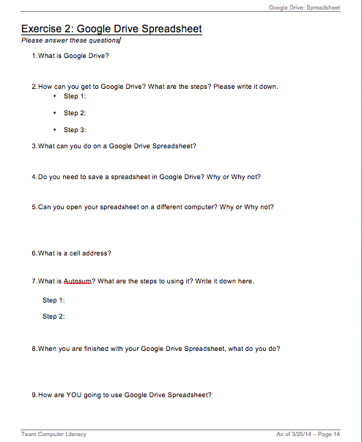
Big Ideas + Real Life
Circle back to the Objectives
Discuss how S plans to use this technology in his/her life.

Slide 25
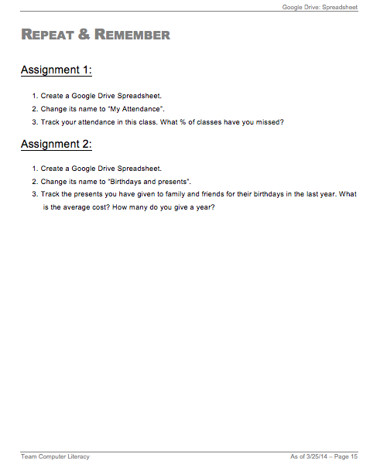
Extension – Repeat & Remember
Tasks to do on their own

Slide 26
Lesson Components
Student Handout
Objectives
Vocabulary & Building Background
Exploring to Learn
Authentic tasks
Assessment
Follow-up
Repeat & Remember
Connections to real life
Teacher’s Guide
NRS/SPL levels
Timeframe
Assumptions
Instructional strategies
Metaphors
Exit ticket ideas

Slide 27
Lesson Accessories
Resources on our website
www.teamcomplit.weebly.com
Screencasts
Tailored vocabulary practice with Quizlet
Connections to existing resources
GCF Learn Free

Slide 28
Screencast Example
http://teamcomplit.weebly.com/google-drive-spreadsheet.html

Slide 29
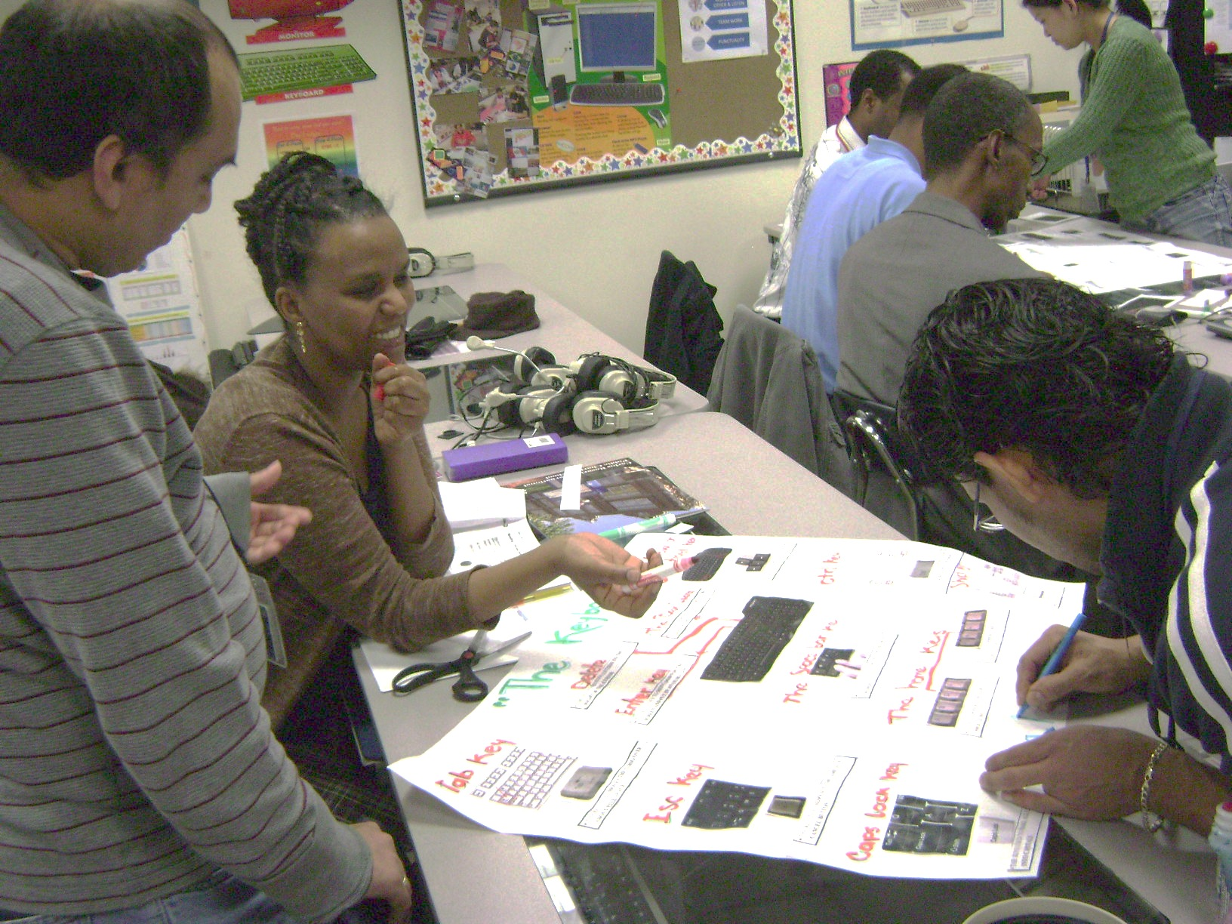
Suggested Sequence – Phase 1 (Entry & Survival)
Hardware
OS
Notepad
Software
Internet
Email
Privacy
Gdrive Doc
Components
On/off
Keyboard
Mouse, mouse skills
Notes:
----- Meeting Notes (3/28/14 08:46) -----
30-40

Slide 30
Suggested Sequence – Phase 1 (Entry & Survival)
Hardware
OS
Notepad
Software
Internet
Email
Privacy
Gdrive Doc
Open, close
Minimize, maximize
Icons
Desktop
Task bar

Slide 31
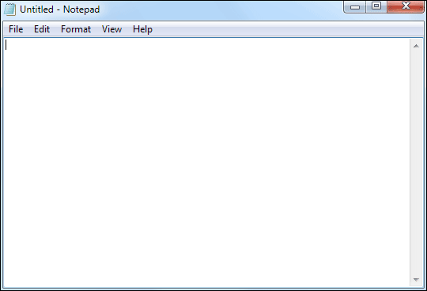
Suggested Sequence – Phase 1 (Entry & Survival)
OS
Notepad
Software
Internet
Email
Privacy
Gdrive Doc
Hardware
Typing
Saving
Mouse pointers
Highlighting text
Copy/paste

Slide 32
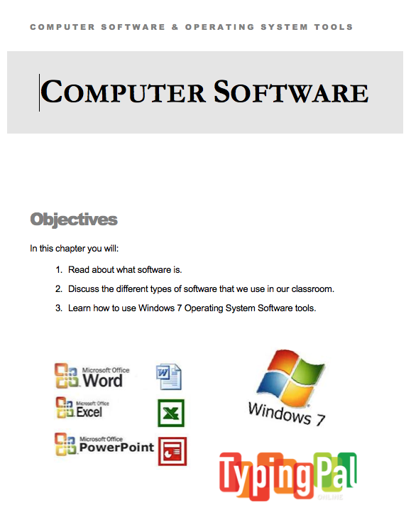
Suggested Sequence – Phase 1 (Entry & Survival)
Hardware
OS
Notepad
Software
Internet
Email
Privacy
Gdrive Doc
Types of programs
Purpose of programs
Web browsers

Slide 33
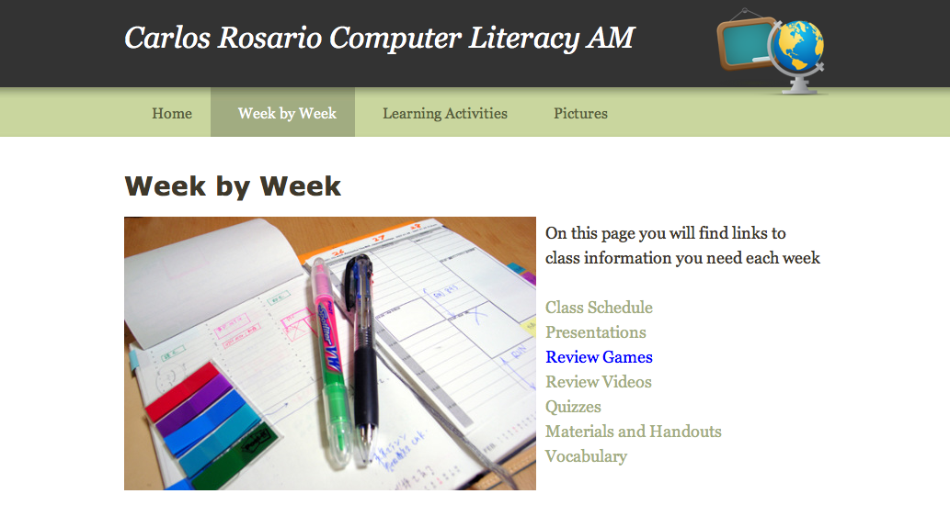
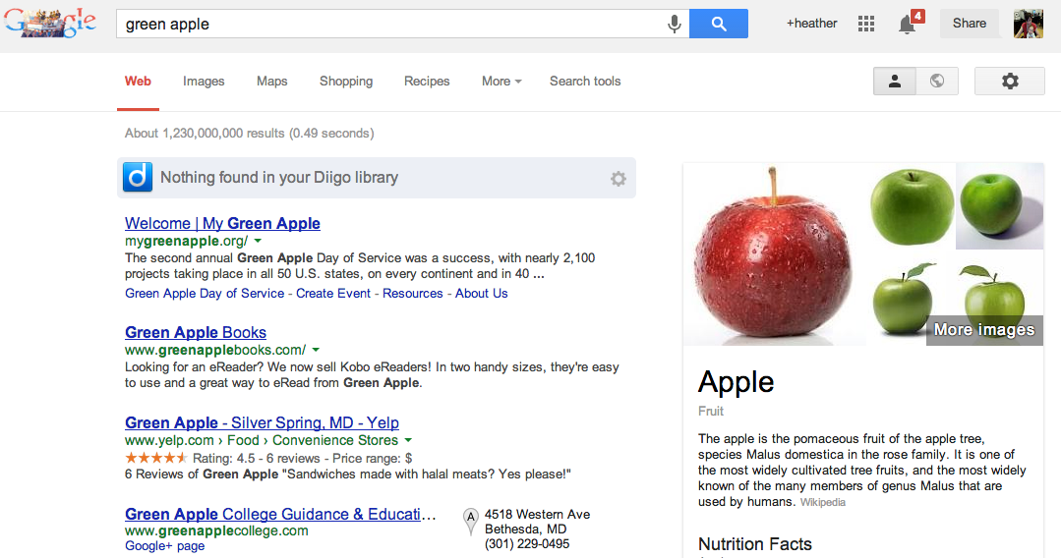
Suggested Sequence – Phase 1 (Entry & Survival)
Hardware
OS
Notepad
Software
Internet
Email
Privacy
Gdrive Doc
Features
Vocabulary
Search engines
Keyword searches

Slide 34
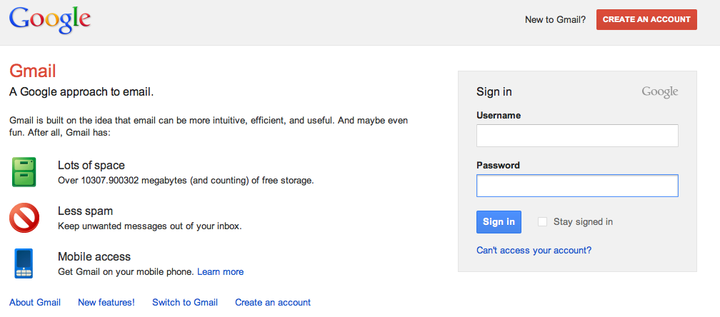
Suggested Sequence – Phase 1 (Entry & Survival)
Hardware
OS
Notepad
Software
Internet
Email
Privacy
Gdrive Doc
Gmail accounts
Vocabulary
Basics

Slide 35
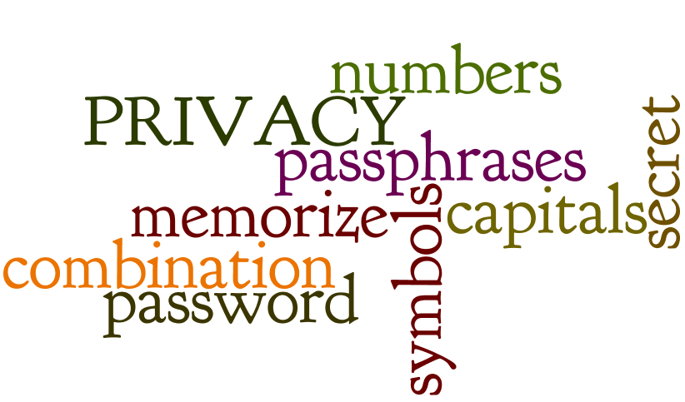
Suggested Sequence – Phase 1 (Entry & Survival)
Hardware
OS
Notepad
Software
Internet
Email
Privacy
Gdrive Doc
Passwords
What is private?

Slide 36
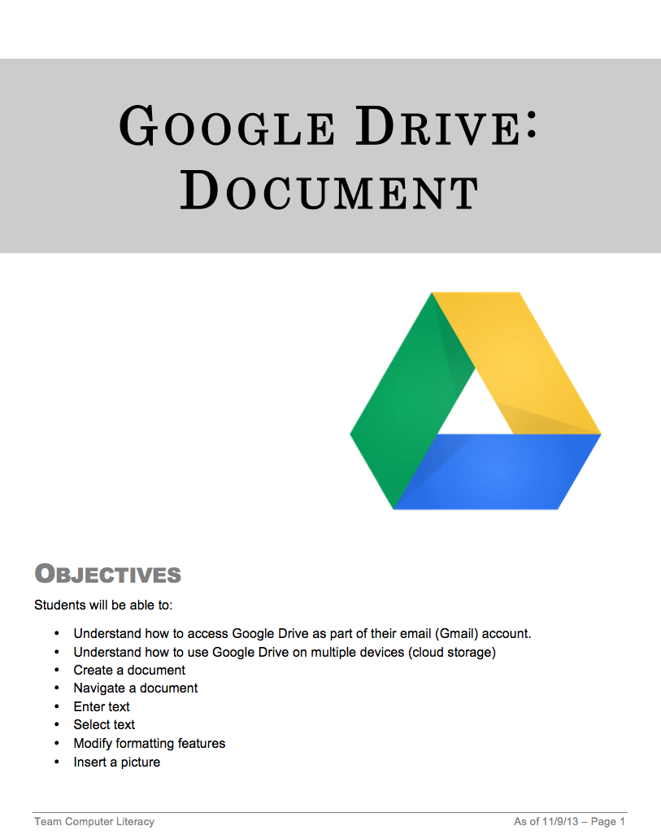
Suggested Sequence – Phase 1 (Entry & Survival)
Hardware
OS
Notepad
Software
Internet
Email
Privacy
G Drive Doc
Basic features
Vocabulary
Create a document

Slide 37
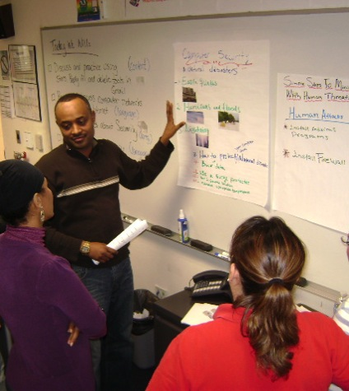
Suggested Sequence – Phase 2 (Stepping Stone)
Security
Word
PPT
Excel
OS II
Google Apps
Privacy
II
Digital Lang.
Software II
Physical security

Slide 38
Suggested Sequence – Phase 2 (Stepping Stone)
Security
Word
PPT
Excel
OS II
Google Apps
Privacy
II
Digital Lang.
Software II
MS Office Applications

Slide 39
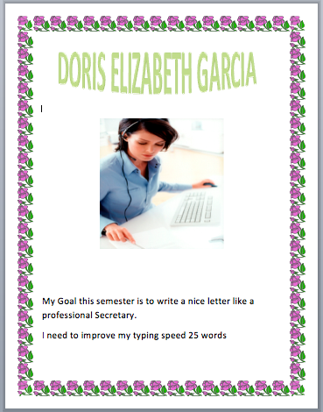
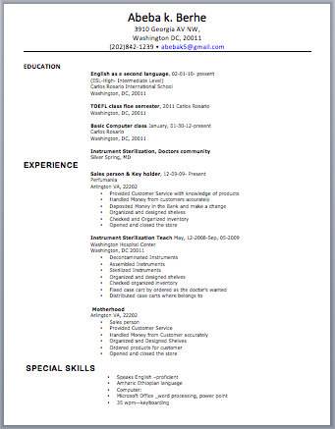
Suggested Sequence – Phase 2 (Stepping Stone)
Security
Word
PPT
Excel
OS II
Google Apps
Privacy
II
Digital Lang.
Software II
Compare to Gdrive
Create basic docs

Slide 40
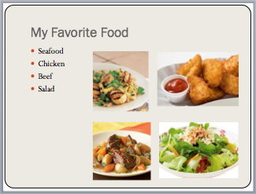
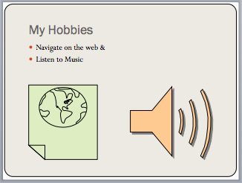
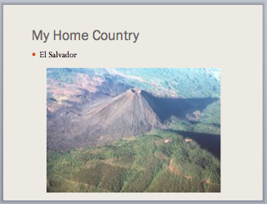
Suggested Sequence – Phase 2 (Stepping Stone)
Security
Word
PPT
Excel
OS II
Google Apps
Privacy
II
Digital Lang.
Software II
Compare to Word
Basic presentations

Slide 41
Suggested Sequence – Phase 2 (Stepping Stone)
Security
Word
PPT
Excel
OS II
Google Apps
Privacy
II
Digital Lang.
Software II
Compare to Word
Personalize
Basic features/ functions

Slide 42
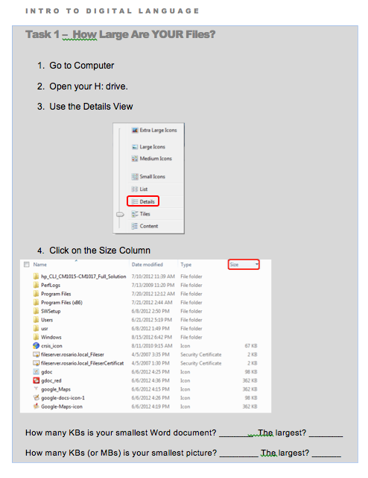
Suggested Sequence – Phase 2 (Stepping Stone)
Security
Word
PPT
Excel
OS II
Google Apps
Privacy
II
Digital Lang.
Software II
File management

Slide 43
Suggested Sequence – Phase 2 (Stepping Stone)
Security
Word
PPT
Excel
OS II
Google Apps
Privacy
II
Digital Lang.
Software II
Mail
Drive
Calendar
Chrome & Apps

Slide 44
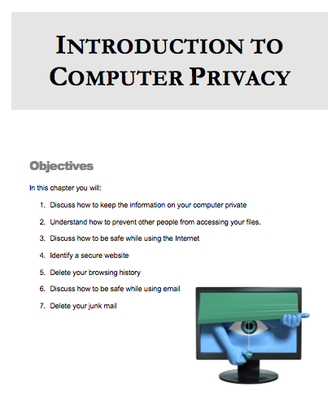
Suggested Sequence – Phase 2 (Stepping Stone)
Security
Word
PPT
Excel
OS II
Google Apps
Privacy
II
Digital Lang.
Software II
Spam
Scams
Secure websites
Browsing history

Slide 45
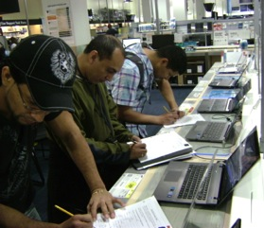
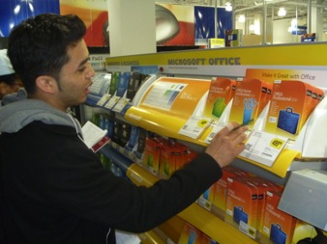
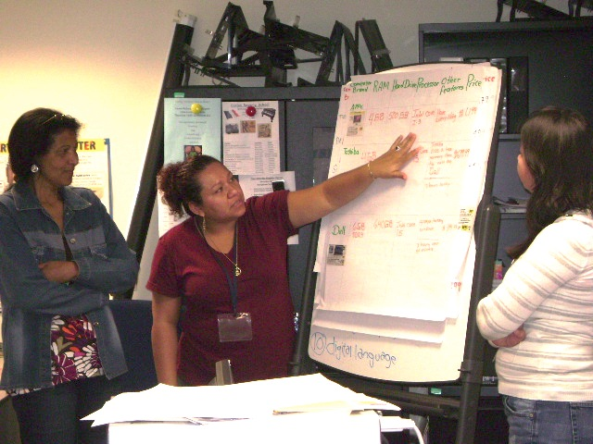
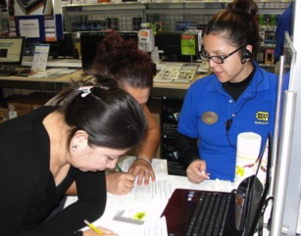
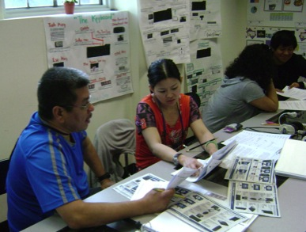
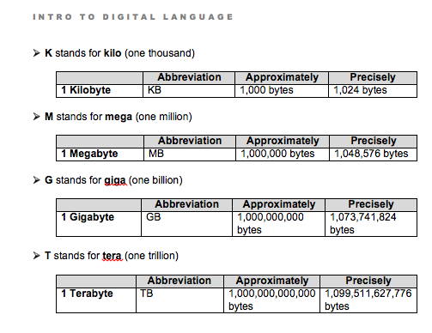
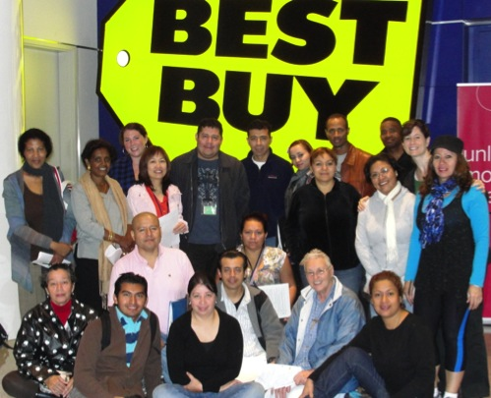
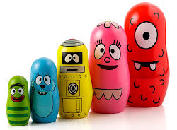
Suggested Sequence – Phase 2 (Stepping Stone)
Security
Word
PPT
Excel
OS II
Google Apps
Privacy
II
Digital Lang.
Software II
Capacity
Vocabulary (KB, MB, GB)
Internal/external/flash drives
Cloud
How to buy a computer

Slide 46
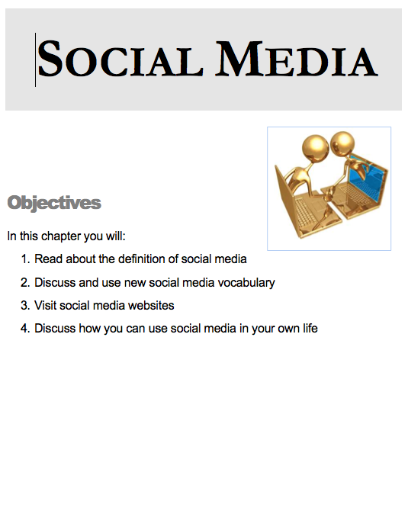
Suggested Sequence – Phase 3 Milestone
Privacy III
Networks & VOIP
Creating
Websites
OS III
Social Media
Twitter
Google +
Facebook
Blogs

Slide 47
Suggested Sequence – Phase 3 Milestone
Privacy III
Networks & VOIP
Creating
Websites
OS III
Social Media
Privacy settings on social networking sites

Slide 48
Suggested Sequence – Phase 3 Milestone
Privacy III
Networks & VOIP
Creating
Websites
OS III
Social Media
User settings in OS
Desktop background
Parental Controls

Slide 49
Suggested Sequence – Phase 3 Milestone
Privacy III
Networks & VOIP
Creating
Websites
OS III
Social Media
Internet connection types
Voice over IP

Slide 50
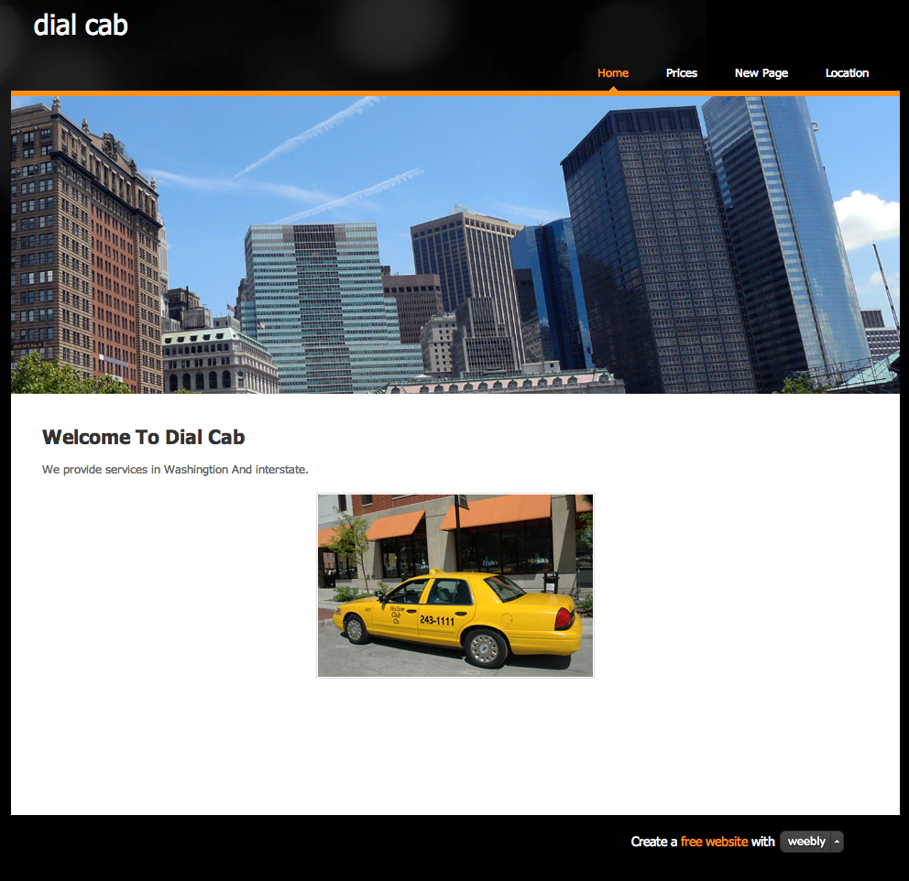
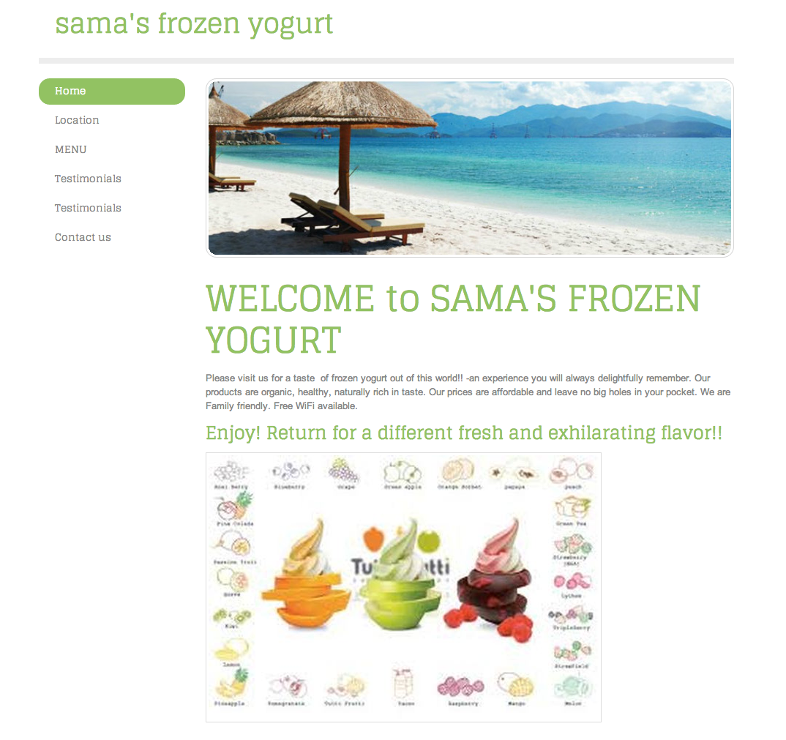
Suggested Sequence – Phase 3 Milestone
Privacy III
Networks & VOIP
Creating
Websites
OS III
Social Media
Culminating project
Create a business

Slide 51
Next Steps
Computer Literacy Collaboration
Choose topic that aligns to your students’ needs
Use our lesson components and format
Share to the bank!
Ensure consistent format
Organize lessons by topic and level

Slide 52
Wrap Up
One take away from this workshop.

Slide 53
References
Cordova & Lepper, 1996. Intrinsic motivation and the process of learning: Beneficial effects of contextualization, personalization, and choice. Journal of Educational Psychology, Vol 88(4), Dec 1996, 715-730.
Echevaria & Graves (2007). Sheltered content instruction: Teaching English language learners with diverse abilities. 3rd Ed. Boston: Allyn & Bacon.
Pugh, 1989. Metaphor and Learning. Reading Research and Instruction, v. 28, 3

Slide 54
Thank you!
Special thanks to First Literacy, Boston for their financial support.
Visit us for future lessons at
www.teamcomplit.weebly.com
Team Computer Literacy:
Neela Jayaraman & Heather Tatton-Harris
Contact us! teamcomplit@gmail.com

